Slide 1
IEP Preparation and Process

Slide 2
Outcomes
Increase Knowledge of Special Education requirements.
Review Parents’ Procedural Rights and Safeguards regarding Special Education Increase Knowledge of the IEP Process
Be Able to Complete a Compliant IEP
Notes:
Speak to the slide and review the handout packet with participants.
Handouts should include:
Copy of PowerPoint presentation
Copy of IEP

Slide 3

What do I want to learn?
List 5 things you would like to know more about regarding the special education process.
At the end of the presentation see if this presentation has provided you with the information and resources you will need to better serve students with disabilities.

Slide 4
District Policies and Procedures

Slide 5

Special Education Electronic Policies and Procedures Manual (e-PPM)
Replaces the 2007 Manual (burgundy binder)
Located in the MCD Monitoring/Policies & Procedures section of the Division of Special Education website. https://achieve.lausd.net/Page/14466
The e-PPM contains updated sections from the
hard manual.

Slide 6
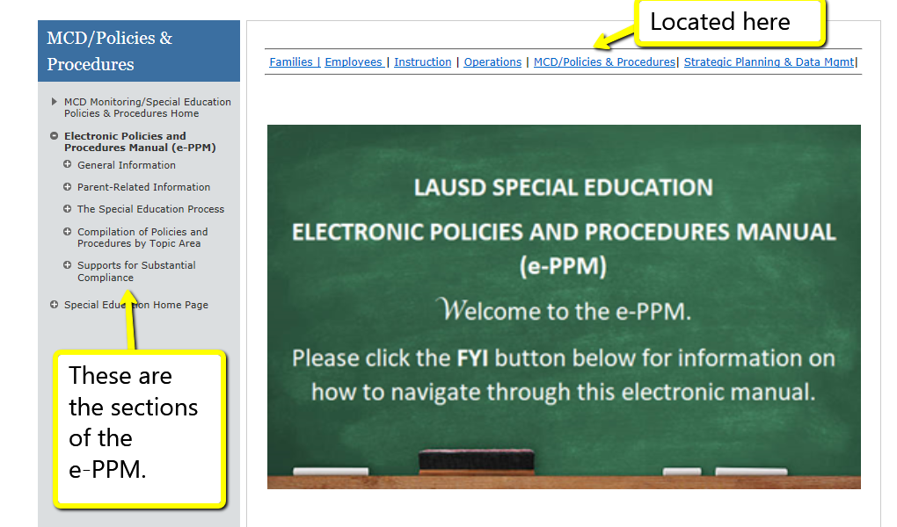
Special Education Electronic Policies and Procedures Manual
(e-PPM)
Notes:
The Special Education Policies and Procedures manual has been replaced by an electronic version which can now be accessed online at https://achieve.lausd.net/Page/14466
Each section of the Electronic Policies and Procedures Manual (e-PPM) can be viewed and accessed via the gray column on the left side of the screen or the icons below the green chalkboard. See next slide.

Slide 7
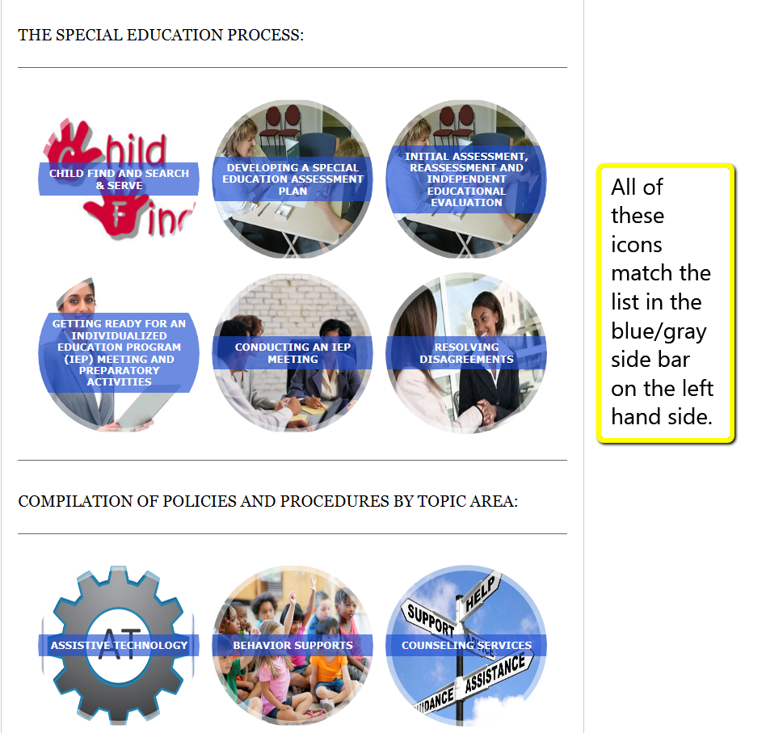
Special Education Electronic Policies and Procedures Manual
(e-PPM)
Notes:
As indicated on the slide, the icons match the list in the gray side bar on the left hand side of the screen.

Slide 8
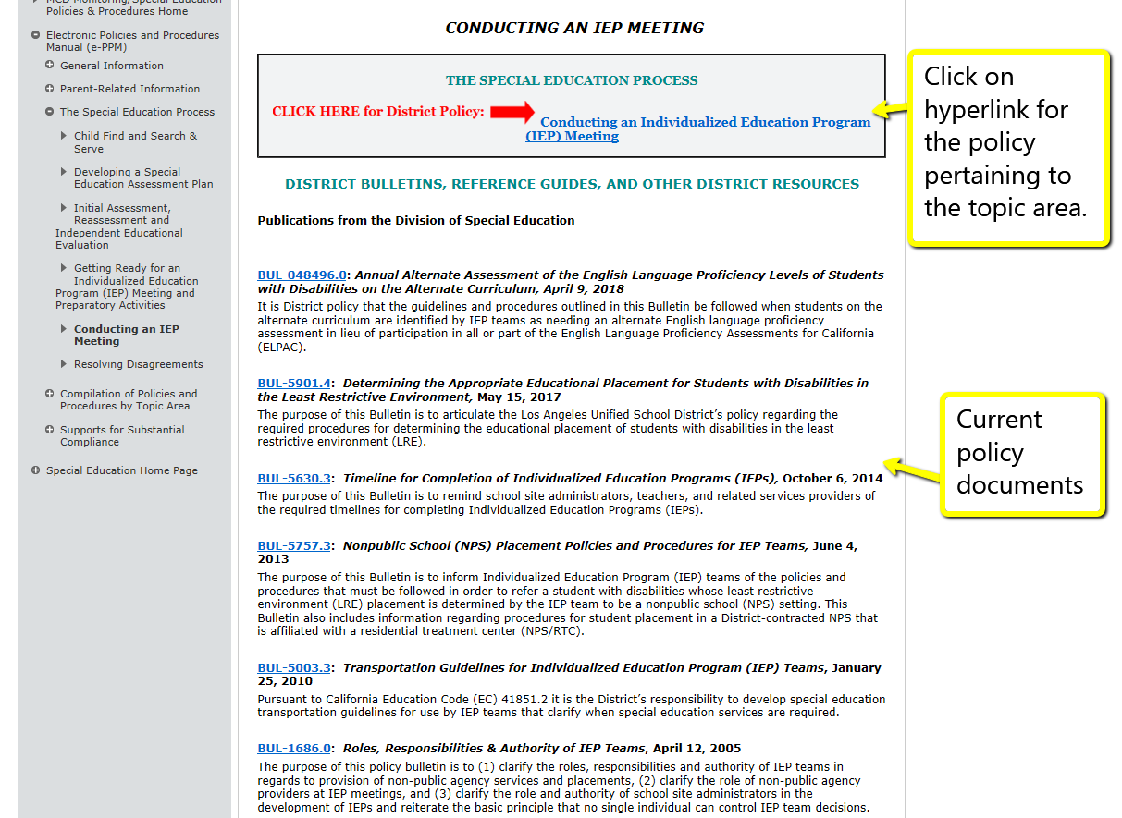
Special Education Electronic Policies and Procedures Manual
(e-PPM)
Notes:
Once an icon is clicked, there is a “Policy” document highlighted with a RED ARROW. This is the DISTRICT POLICY which outlines procedures for school staff to follow.
Under the policy document, there are applicable publications that support the section. These publications may be listed in more than one section as applicable.
These policy documents are public.

Slide 9
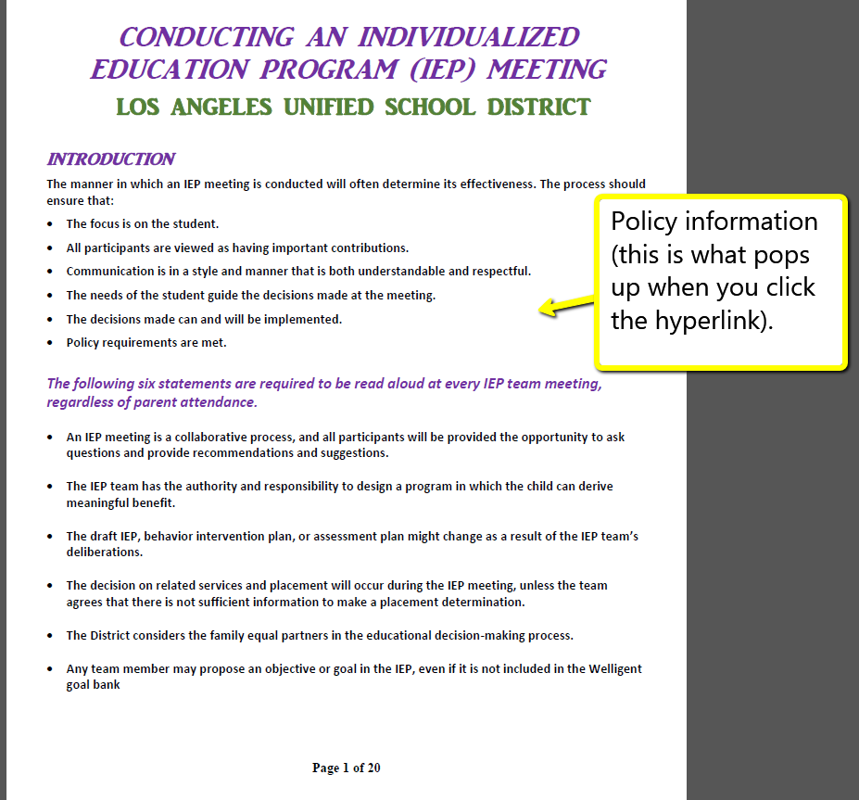
Special Education Electronic Policies and Procedures Manual
(e-PPM)
Notes:
Here is an example of the policy document for “Conducting an Individualized Education Program (IEP) Meeting. This is what will pop up when the RED ARROW policy document is clicked.

Slide 10
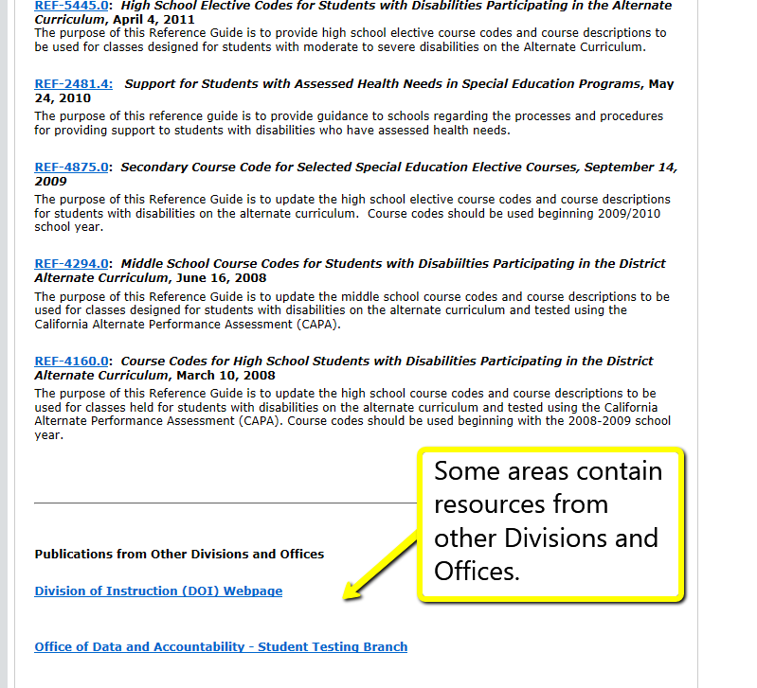
Special Education Electronic Policies and Procedures Manual (e-PPM)
Notes:
Some sections contain publications and resources from other Divisions and Offices. There may be some protected and therefore an employee sign-in to MyLAUSD may be required. The next slide describes this process.

Slide 11

MyLAUSD
MyLAUSD is the name of the District e-Library and replaces Inside LAUSD.
The system was upgraded during the 2017-18 school year.
“Classic View” of website used for this visual aid.
Notes:
“MyLAUSD” can be accessed via the landing page of the LAUSD website. For this visual aid, we have used the “Classic View” of the website.

Slide 12
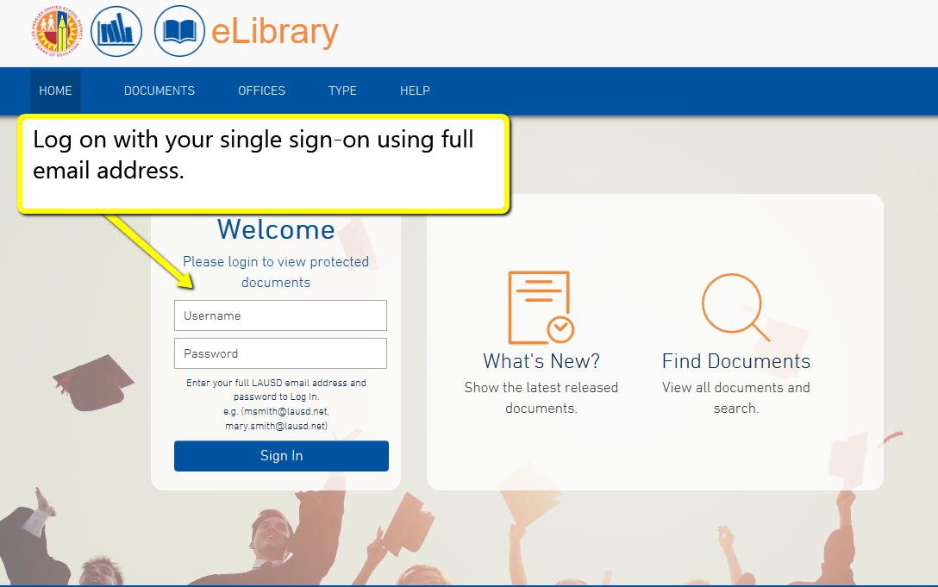
MyLAUSD
Notes:
Once you have clicked on MyLAUSD, you will need to use your single sign-on using your full email address. See the text boxes on the next few slides for directions.

Slide 13
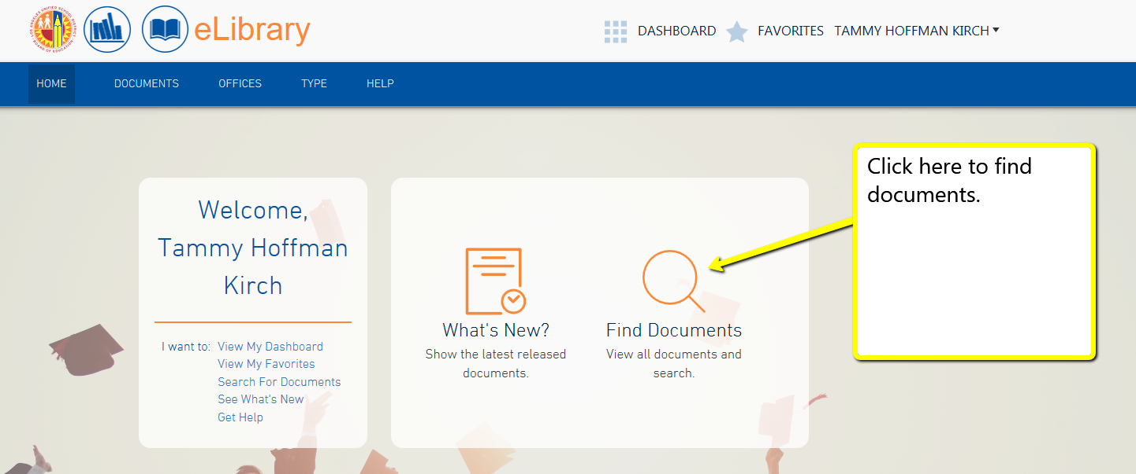
MyLAUSD

Slide 14
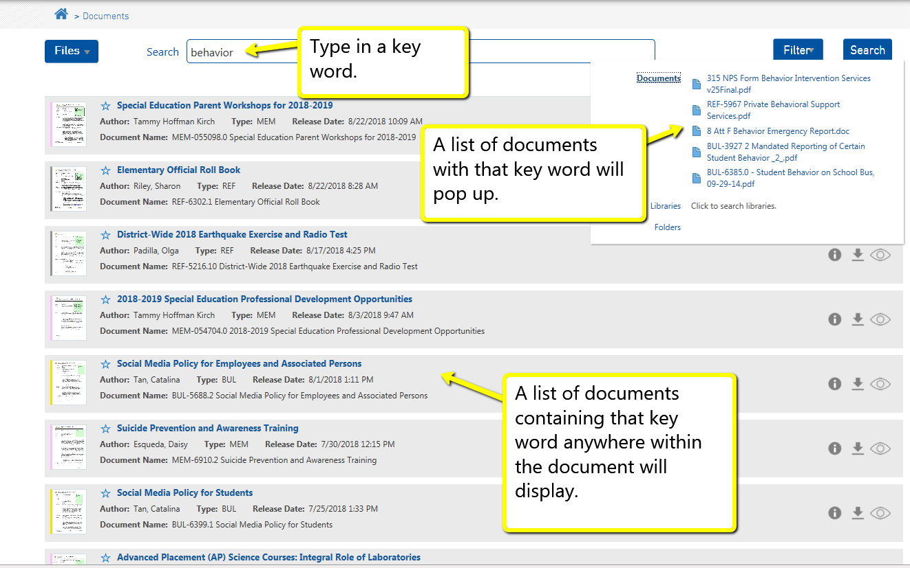
MyLAUSD

Slide 15
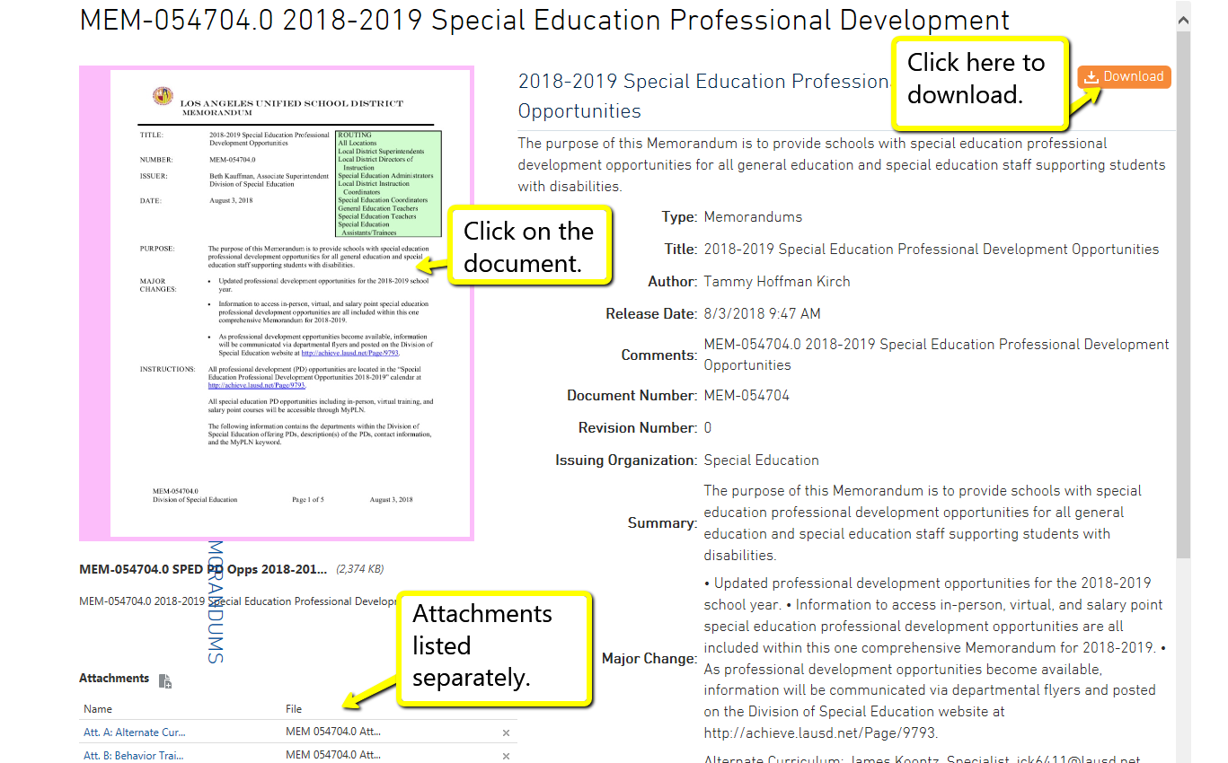
MyLAUSD

Slide 16
Special Education Legal Principles and Requirements

Slide 17
Legal Mandates
Federal Law
  Individuals with Disabilities Education Act (IDEA) 2004, Code of Federal Regulations
State Law
  California Education Code (EC)

Slide 18
What is an IEP?
A federal law called the Individuals with Disabilities Education Act (IDEA) requires that public schools create an Individualized Education Program (IEP) for students who receive special education services. It addresses the child’s unique learning needs. It is a legally binding document that is revised every year at the IEP meeting.
The IEP must be implemented by the school as soon as possible upon consent by the parent.
All responsible staff must have access to the pertinent parts of the IEP.
Notes:
Review slide.
A federal law called the Individuals with Disabilities Education Act (IDEA) requires that public schools create an Individualized Education Program (IEP) for students who receive special education services. It addresses the child’s unique learning needs. It is a legally binding document that is revised every year at the IEP meeting. It must be implemented by the school as soon as possible upon consent by the parent.
Discuss how if there is going to be a change to a student’s educational program/services, there needs to be an IEP to address that change in needs.
IMPLEMENTATION OF THE IEP- the law requires that the District implement the IEP as soon as possible upon consent by the parent. This means that all services, supports, goals, objectives, accommodations and supplementary aids are strictly implemented as soon as possible. Failure to implement the IEP is by far the most frequent complaint filed by parents. The school must have a system in place to ensure responsible staff have access to the IEP or the pertinent part of the IEP. Substitute teachers must also be aware of their responsibilities to the applicable elements of a student’s IEP or Section 504 Plan.

Slide 19
Free Appropriate Public Education (FAPE) and the IEP
The IEP Team has the responsibility for determining and documenting within the IEP an offer of a free, appropriate public education (FAPE) that includes recommendations for specially designed instruction to address the child’s unique needs.
Included in the offer of FAPE is a specific offer of placement that is designed to meet the student’s unique needs, is reasonably calculated to provide educational benefit, and is in the least restrictive environment to the maximum extent appropriate.
See District Reference Guide REF. 5901.4- Determining the Appropriate Educational Placement for Students with Disabilities in the Least Restrictive Environment (LRE)
Notes:
Throughout this presentation, applicable District policy documents will be listed as references. Please learn to access MyLAUSD for

Slide 20
Least Restrictive Environment (LRE)
The Individuals with Disabilities Education Act (IDEA) requirement that students with disabilities be placed in the “least restrictive environment” means that students with disabilities must be educated with their nondisabled peers, to the maximum extent appropriate, as determined by the individualized education program (IEP) team.
The general education classroom where the student has the greatest opportunity to be integrated with their nondisabled peers is the first educational setting that the IEP team must consider.
REF – 5904. 5

Slide 21

Types of IEPs
Initial
  One initial
Annual Review
  Within 12 months
Three Year Review
  Within 36 months
30 Day
  Transfer-In from Out-of-District or Independent Charter Schools
  Parent Request
Amendment IEP
  Add or revise PLPs, and/or goals, and objectives
  Add or delete a service
  Not for change of placement or eligibility

Slide 22
Who attends the IEP Team Meeting?
Parent*
Administrator/Administrative Designee*
Special Education Teacher*
General Education Teacher*
Student (if appropriate)
DIS (Related Services) Provider
School Psychologist
School Nurse
Interpreter (if needed or requested by parent)
* Required
Notes:
Review slide.
Add that while a parent may bring people to the IEP meeting, they are not a part of the IEP team (they do not make decisions). Remember that both the District and the parent may invite outside parties to the meeting that can provide information relevant to the student or in the case of the parent, provide support to the parent.

Slide 23

Understanding Legal Timelines
When Must an IEP Team Meeting be Held?
At least once every 12 months
Within 30 days of a request by the parent of a special education student
Within 30 days of a special education student’s transfer into the District from an outside district.
Within 60 days of receipt of an assessment plan signed by the parent.

Slide 24
Understanding Legal Timelines (Continued)
Inform administrator immediately if a request for Special Education assessment is received—a proposed assessment plan must be provided to the parent within 15 calendar days.
Once the parent returns the signed assessment plan, the school must complete all applicable assessments and conduct the IEP meeting within 60 days from the date the signed assessment plan was received by the school.
Notes:
Adhering to mandatory timelines is a crucial part of maintaining compliant and effective programs for students with disabilities. Federal laws, the Individuals with Disabilities Education Act (IDEA), in addition to State law, the California Education Code, dictate due dates and timelines we must follow as a school district. Noncompliance results in serious consequences to the District not to mention the harm it can do to students’ educational programs. It is essential that school systems strive to maintain these timelines.
The next few slides provide you with some of the most important. At the end of this presentation, you will be quizzed on the various timelines. Your role is a key component to this process. Thank you in advance for being a part of this important process for students with disabilities!

Slide 25
Understanding Legal Timelines (Continued)
If the parent of a special education student requests pupil records, the records must be provided within 5 business days of the request.
  See District Policy BUL - 5526.6 Procedures for Requests for Educationally Related Records of Students with or Suspected of Having Disabilities
Notes:
When a special education student transfers into the District from another school district, an IEP meeting must be held within 30 calendar days.
When a parent of a special education student requests an IEP meeting the school must conduct an IEP meeting within 30 calendar days of the request.
If a parent of a special education student requests pupil records, the records must be provided within 5 business days of the request.
Important:
Please see District Policy BUL - 5526.6 Procedures for Requests for Educationally Related Records of Students with or Suspected of Having Disabilities. This bulletin describes additional procedures required for the processing of special education student records, therefore it is imperative that this policy be well understood and its procedures followed in a timely manner.

Slide 26
Understanding Legal Timelines (Continued)
If a parent requests to audio record the IEP meeting, they must notify the school at least 24 hours before the IEP meeting. It is recommended that the school also audio record in this instance. (The District may not refuse this request if notification was received at least 24 hours in advance of the IEP meeting. Conversely, the parent has the legal right to refuse to allow the District to audiotape if requested by the school.)
If a parent requests assessment report(s) in advance of an upcoming IEP meeting, the school must provide them to the parent 4 calendar days prior to the IEP meeting.
Notes:
Assessment Reports-
Parents have a right under law to meaningfully participate in the special education process. As such, they may want to review assessment reports ahead of the meeting to be better prepared and informed. The assessment reports must be provided to the parent 4 days in advance of the meeting.
Upon receipt of the signed assessment plan, please note if the parent requests the assessment reports in advance of the meeting. Please notify assessors of the parent’s request. Failure to provide the assessment reports 4 days in advance could potentially be determined a violation of special education laws.
Audio-taping or tape recording-
The parent is required to NOTIFY the District 24 hours or one day in advance of an IEP meeting. As long as the 24 hour notification is received, the District must comply. Schools should be prepared to use their own equipment to tape as well.
In contrast, if the District initiates a request to audio-tape and the parent refuses, the District may NOT proceed with audio-taping.

Slide 27
Understanding Legal Timelines
(Continued)
The word “days” in the preceding slides refer to “calendar days” unless otherwise noted, e.g. 5 business days for records requests.

Slide 28
Required Procedures for Processing Forms and Requests from Parents
All documents received from parents must be time-stamped and a copy provided to the parent.
Upon receipt of a request for assessment, signed assessment plan, request for IEP meeting, student records or IEP meeting notification, complete all applicable Welligent fields to record all dates so that required timelines will be met.
District policy requires that Parents be provided 10-day notice of an upcoming IEP meeting.
Positive working relationships with parents are recommended.
All relevant parent correspondences should be documented on the IEP Meeting screen in Welligent.
Notes:
Parents are our partners in the their child’s educational journey.
As such we need to work together to enhance opportunities and educational benefit for each child. The District must implement efficient practices starting in the school office to foster this relationship.
It is important that standardized procedures are followed when receiving and processing forms and requests from parents. Any verbal requests made by parents should be put in writing. The law requires that the District facilitate these requests by assisting the parent. As office staff, please assist the parent in putting any requests in writing and dating each request. Time-stamp the request, provide a copy to the parent and a copy for school records. Ensure that the request is promptly addressed.
The law requires that the parent is notified of upcoming IEP meetings within a reasonable time. The District has defined “reasonable time” as 10 days. Therefore IEP meeting notifications must be provided to parents at least 10 days in advance of an IEP meeting.
Remember to document all your efforts on the IEP Management Screen in Welligent under Notes.

Slide 29
Enrollment Reminders for Schools
How do you know if a new student enrolling in your school requires special education services?
  Office staff must confirm that the parent has completed the “Special Services” Section #10 of the District’s student enrollment form.
  School staff must ask parent to submit a copy of current IEP as soon as possible.
  Schools must never delay or deny enrollment to a student based on a missing IEP.
Notes:
How do you know if a new student enrolling in your school requires special education services?
Confirm that the parent has completed the “Special Services” Section #10 of the District’s student enrollment form.
Ask parent to submit a copy of current IEP before completing enrollment process.
Contact Special Education Operation Unit at 213-241-6701 for placement in Special Day Programs.
Follow up is crucial because we do not want to deny or delay enrollment. Consult with your administrator if you are having difficulty with placement.

Slide 30
Maintenance of Student Records
Each student with an IEP requires a green folder or a confidential special education folder in his/her cumulative file (cum).
  If student is no longer eligible for Special Education Services the green folder should be turned upside down and kept in the cum.
An Access Log must be stapled to the outside front cover of the green folder.
Names of staff who have routine access to student IEPs must be posted on the filing cabinet housing IEPs.
Reminder: IEPs are confidential so they must be handled accordingly.
Notes:
The maintenance of accurate student records is an important responsibility.
Each student with an IEP needs a green folder in his/her cumulative file.
If student is no longer eligible for Special Education Services the green folder should be turned upside down and kept in CUM.
An Access Log needs to be posted on the outside front cover of the green folder. This should be updated every time school personnel access the green folder.
Names of staff who have routine access to student IEPs needs to be posted on the filing cabinet housing IEPs.
Reminder: IEP are confidential so they must be handled accordingly.

Slide 31
Maintenance of Student Records (Continued)
Names of staff who have routine access to student IEPs must be posted on the filing cabinets housing the IEPs and cumulative folders.
Notes:
Names of staff who have routine access to student IEPs need to be posted on the filing cabinets housing the IEPs and cumulative folders.

Slide 32
Maintenance of Student Records (Continued)
Access Log
_____________
_____________
Contents of the Green Folder
  Access Log (Adhere to outside front cover)
  Parent Request for Reasonable Accommodations (Adhere to inside front cover)
Contents in Chronological Order (most recent on top)
  Request for Special Education Assessment
  Special Education Assessment Notification
  Special Education Assessment Plan
  Notification to Participate in an IEP Meeting
  Excusal Form
  Assessment Reports (excluding Psychologist & Nurse)
  IEP
Notes:
Make sure each document is secured – use prongs
No duplicate copies
Check formatting – no blank pages, staff/parent surveys in the folder, check that the radio buttons are filled in
Label green folders (VOL 1, VOL 2, etc) when folders get too full

Slide 33
ACTIVITY #2

Slide 34

Activity #2
Time to Test Your Knowledge !
Notes:
Let’s see how well you were listening!
Take a look at the next few slides. We will read them together aloud and see if someone can provide the answer. ( Answers will be on subsequent slide.).

Slide 35
Timelines Are Ticking
QUESTION:
If a parent requests an assessment, when is the school required to provide an assessment plan?
Within
10 days
Within
30 days
Within
15 days
Notes:
QUESTION:
If a parent requests an assessment, when are you required to provide an assessment plan?
Within 10 days? Within 30 days? Or Within 15 days?
(The next slide provides the correct answer.)

Slide 36
Timelines Are Ticking
ANSWER:
A proposed assessment plan is to be provided to the parent within 15 calendar days of the request for assessment.
Notes:
A proposed assessment plan is to be provided to the parent within 15 calendar days of the initial request for assessment.
When you receive a direct request for assessment, it is essential for an administrator to review the request. The administrator will review student records and determine the appropriateness of the request. In cases where the administrator is denying the request, the parent will be provided with a written response from the administrator explaining why the request is being denied and what steps the school will take in order to address the parent’s concern.

Slide 37
Timelines Are Ticking
QUESTION:
If the parent consents to assessment and returns the signed assessment plan, within how many days of the school’s receipt of the signed assessment plan must assessments be completed AND the IEP meeting held?
Within
30 days
Within
60 days
Within
80 days
Notes:
Question:
If a parent consents to assessment(s) and returns the signed assessment plan, within how many days of the school’s receipt of the signed assessment plan must assessments be completed AND the IEP meeting HELD?
Within 30 days? Within 60 days? or Within 80 days ?

Slide 38
Timelines Are Ticking
ANSWER:
Assessments must be completed and the IEP meeting HELD within 60 days of receipt of the signed assessment plan.
Notes:
Answer:
The school has 60 days to complete assessments and hold the IEP meeting. However, it may be useful to schedule the IEP meeting earlier in order allow for an unexpected event and still meet the timeline requirement.

Slide 39
Timelines Are Ticking
QUESTION:
How many days prior to the IEP meeting date must the school give parents written notification of the meeting?
Within
10 days
Within
20 days
Within
30 days
Notes:
QUESTION:
How many days prior to the IEP meeting date must the school give parents written notification of the meeting?
Within 10 days? Within 20 days? Or Within 30 days?

Slide 40
Timelines Are Ticking
ANSWER:
Per District Policy, an IEP Meeting Notification is sent at least 10 days before the meeting along with the Parent’s Guide to Special Education, The IEP and You booklet, and The ITP and You booklet (for students age 14 and older).
Notes:
ANSWER:
The IEP Meeting Notification is sent at least 10 days before the meeting. Along with notifying the parents of the meeting, you need to provide parents with the following required publications: Parent’s Guide to Special Education, The IEP and You booklet, and The ITP and You booklet (for students age 14 and older).
If the parent does not return the signed notification, the school must make at least 3 attempts (by phone and/or by mail) to contact the parent to return the notification). Document the attempts in Welligent on the IEP Notification form. An IEP meeting cannot be held without the parent’s participation unless the school obtains a signed consent to proceed with the IEP meeting without the parent(s). Do not move forward with an IEP meeting with a verbal ok from the parent. ALL must be in writing and uploaded to Welligent once signed.

Slide 41
Timelines Are Ticking
QUESTION:
When a new special education student transfers into the District, within how many days of enrollment must an IEP meeting be held?
Within
10 days
Within
20 days
Within
30 days
Notes:
QUESTION:
When a new special education student transfers into the District, within how many days of enrollment must an IEP meeting be scheduled and held?
Within 10 days? Within 20 days ? Or Within 30 days?

Slide 42
Timelines Are Ticking
ANSWER:
An IEP meeting must be held within 30 calendar days of enrollment.
Notes:
ANSWER: When a student with an IEP transfers into the District, the school must enroll the student without delay and develop an LAUSD IEP within 30 calendar days of enrollment.

Slide 43
Timelines Are Ticking
QUESTION:
If a parent of a special education student requests an IEP meeting, within how many days must the school schedule and conduct the IEP meeting?
Within
10 days
Within
20 days
Within
30 days
Notes:
Question :
If a parent of a special education student requests an IEP meeting, within how many days must the school hold the IEP meeting?
Within 10 days ? Within 20 days? Or Within 30 days ?

Slide 44
Timelines Are Ticking
ANSWER:
An IEP meeting must be held within 30 calendar days of the request.
Notes:
ANSWER:
When the school receives a request for a review IEP from the parent of a special education student,, an IEP meeting must be held within 30 days.

Slide 45
Understanding Parents’ Rights in the Special Education Process

Slide 46
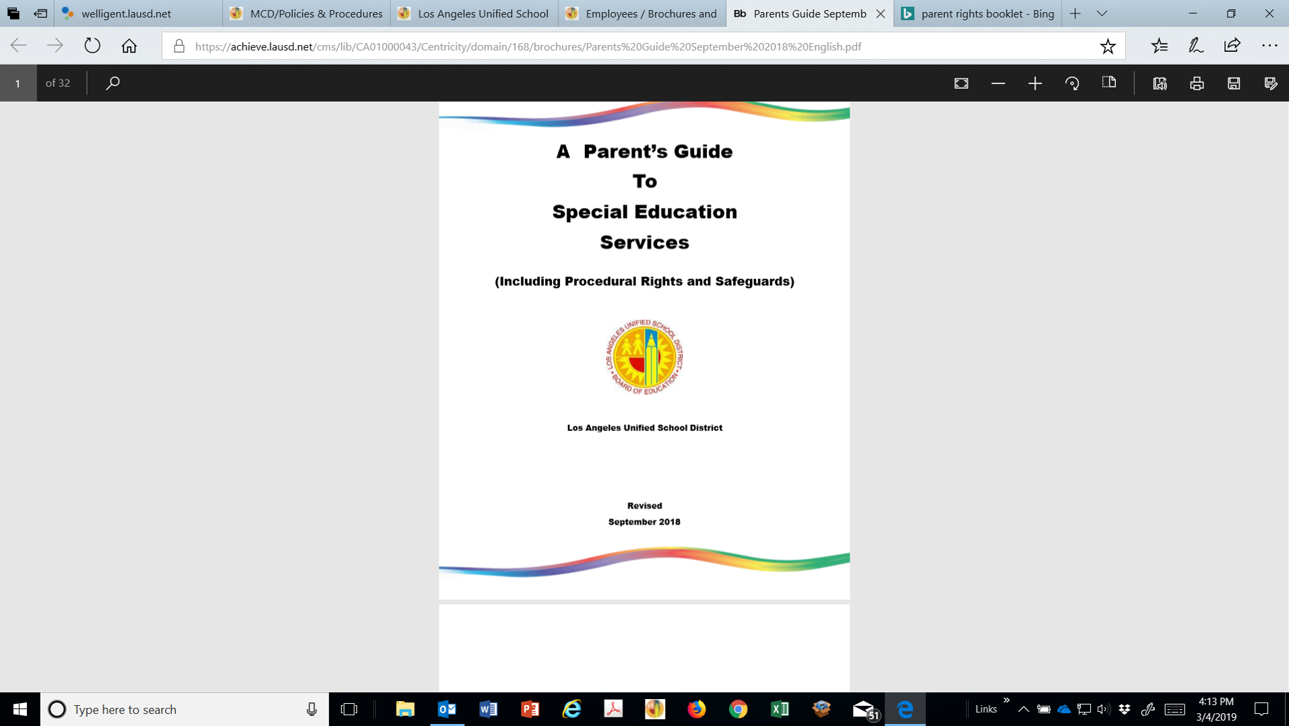
Booklet of Parents’ Rights:
A Parent’s Guide to Special Education Services (Including Procedural Rights and Safeguards)
This booklet contains a thorough explanation of the special education process. Please take the time to read it as it will assist you in better understanding special education in the District.
Notes:
A Parent’s Guide to Special Education Services (Including Procedural Rights and Safeguards) is the District’s official notice to parents of their rights that are required by Federal and State law.

Slide 47
Parents Have a Right to be Informed of their Procedural Rights and Safeguards
The District must distribute:
  A Parent’s Guide to Special Education Services (Including Procedural Rights and Safeguards)
    With initial referral for assessment
    With assessment plan
    At IEP meeting
    Parent request
Notes:
A Parent’s Guide to Special Education Services (Including Procedural Rights and Safeguards) is the District’s official notice to parents of
their rights that are required by Federal and State law.
A Parent’s Guide to Special Education Services must be provided to parents once in a school year and, additionally, in the specific circumstances noted on the slide.
Each of the parents’ rights outlined in the guide will be briefly explained in the following slides.

Slide 48
Parents Have a Right to Participate
Every parent has the right to participate in all decision-making meetings held in order to develop an educational program for their child.
It is the District’s legal responsibility to ensure each parent is provided an opportunity to participate if they choose.
To enable informed decision-making and meaningful participation, provide timely notification and communication to parents in their primary language.
Notes:
Every parent has the right to participate in all decision-making meetings held in order to develop an educational program for their child.
It is the District’s legal responsibility to ensure each parent is provided an opportunity to participate if they choose.
To enable informed decision-making and meaningful participation, provide timely notification and communication to parents in their primary language.

Slide 49
Parents Have a Right to Consent
Initial Assessment
Initial Provision of Special Education Services
Release of Educational Records
Parent consent is required before any of the actions listed above can take place.
Notes:
Parents must be provided with a prior written notice document and give written consent, before the District can conduct an initial assessment, provide special education services, and release educational records to an out-of-District person or agency representative.

Slide 50
Parents Have a Right to Prior Written Notice
The District MUST provide parent with written notice:
  BEFORE it proposes or refuses to assess a student
  BEFORE it proposes or refuses to change a student’s:
    Identification or Eligibility
    Educational placement or setting
    Special education services
Notes:
Parents must be given prior written notice before the District proposes or refuses the actions listed on the slide.

Slide 51
Parents Have a Right to Access Educational Records
Request May Be Oral or Written
Within 5 Business Days of Request Parents May:
  Inspect and review records
  Request explanation/interpretation of records
  Be provided copies of pupil records
Notes:
Parents have the right to access their child’s educational records. The request may be oral or written. Within five business days of the request, parents may inspect and review records, ask for an explanation or interpretation, and be given copies of the records. Assist parent with putting their request in writing. Time-stamp their request and provide them with a copy. Follow all procedures outlined in LAUSD District Policy BUL - 5526.6 Procedures for Requests for Educationally Related Records of Students with or Suspected of Having Disabilities.

Slide 52
Parents Have a Right to Procedural Safeguards to Resolve Disagreements regarding the following elements of the IEP:
Assessment
Eligibility
Instructional Setting
Services
Notes:
Parents have the right to be informed of procedural safeguards to resolve disagreements over what is appropriate for their child with regard to assessment, eligibility, instructional setting, and services. (four main elements of the IEP or offer of FAPE)

Slide 53
Parents Have a Right to Pursue Dispute Resolution Processes
Informal Dispute Resolution (IDR)
Mediation Only
Formal Due Process Hearing
See LAUSD Policy REF-1410.9 Special Education Dispute Resolution - The Three Options For Parents Wishing to Initiate a Form of Dispute Resolution Regarding the Proposed Components of an IEP: (1) Informal Dispute Resolution, (2) State Mediation Only, and (3) Formal Due Process Hearing
Notes:
Parents may elect to resolve IEP disagreements using the procedures noted on the slide.

Slide 54
Parents Have a Right to File a Complaint
Local Complaint
  Uniform Complaint Procedures (UCP)
State Complaint
  California Department of Education (CDE)
Local/State Complaint Procedures
  Investigation
  Written decision
  Appeal process
Notes:
Parents have a right to file a local or State complaint to resolve alleged violations of special education law such as exceeding timelines or failure to implement the IEP as written.
The local complaint process is called Uniform Complaint Procedures (UCP). Parents are informed of this process by means of a UCP brochure disseminated annually by the District. Instead of a local complaint, parents may file directly to the California Department of Education (CDE) to address their complaint.
Both local and State complaint procedures require that an investigation be conducted and a decision rendered in writing to parents. Parents are afforded an appeal process if they disagree with the written decision notice.

Slide 55
Parent Rights and Student Discipline
Parents May Request
  IEP Meeting
  Behavior Assessment
School Personnel May
  Make change in placement due to misconduct
    10 day suspension
    Interim Alternative Educational Setting (IAES)
    Expulsion
Explanation of Discipline Proceedings
Notes:
If a child is having behavior problems, parents have a right to request an IEP meeting to discuss appropriate instruction, behavior management techniques, and other behavioral supports for their child, such as a Behavior Support Plan. If the behavior is serious, parents may request a behavior assessment.
School personnel may change the placement of a child who violates a student code of conduct. This change of placement may be suspension for ten school days, placement to an Interim Alternative Educational Setting, or expulsion.
A Parent’s Guide to Special Education Services provides an explanation of the required procedural rights and safeguards afforded to parents during student discipline proceedings.

Slide 56
Private School Reimbursement
Unilateral Private School Placement
  Child previously receiving District services
  Parents enroll child in private school without consent or referral by District
Reimbursement Reduced or Denied if Parents Failed to Notify District
  Rejecting District’s placement
  Concerns regarding placement
  Intent to enroll child in private school and seek District reimbursement
Notes:
When a child is receiving special education services from the District and parents enroll their child in a private school without consent or referral by the District, this action is called unilateral placement.
If parents unilaterally enroll their child in a private school, reimbursement for private school placement may be reduced or denied if parents did not give the District notice that: (1) Parents were rejecting the District’s placement, (2) Parents did not express their concerns regarding the placement, and (3) Parents intended to enroll their child in a private school and request reimbursement from the District.

Slide 57
Surrogate Parents in the IEP Process
No Parent/Guardian Can Be Identified
Parent/Guardian Cannot Be Found
Child Is Ward of State
Court Has Limited Parent/Guardian Educational Decision Making Rights
Child Is Homeless and Not in Physical Custody of Parent/Guardian
Notes:
To protect the rights of a child, the District assigns a surrogate parent to represent the child in educational decision making matters required by special education law. A surrogate is assigned to a child in the circumstances noted on the slide. Please contact your Local District Special Education Administrator when the school is in need of a surrogate parent.

Slide 58
Navigating Welligent and IEP Management Tools

Slide 59
Welligent Training
Go to MyPLN to enroll for training:
  Logon to https://achieve.lausd.net/mypln using your Single Sign On.
  Search under Keyword:
    Welligent 101 Basic Optimize IEP
Notes:
If you have not already had Welligent training, it is essential that you go to MyPLN to enroll. To get to MyPLN, go to Inside LAUSD and login. Look up MyPLN and register for a Welligent training.
The following slides will provide you with an overview of the Welligent management screens. Though most of these responsibilities fall under the purview of the clerical support person, as a teacher you may need to be able to conduct some of the activities described in the following slides.

Slide 60
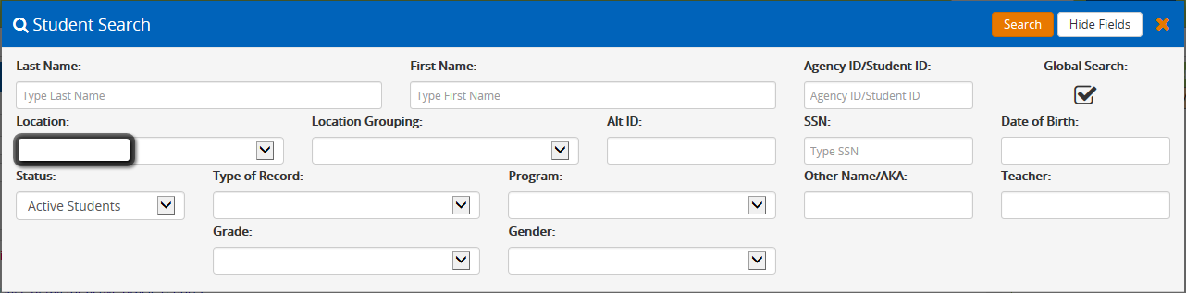
Open IEP in Welligent or Find a Student
Notes:
In the Student Search box, enter last name, first name , or Student ID.
* FYI – Multiple students with the same name may appear. Verify student’s date of birth to confirm the correct student.
* Once you have located the student on the list, click on the icon under the edit column. This will open up the student’s IEP

Slide 61
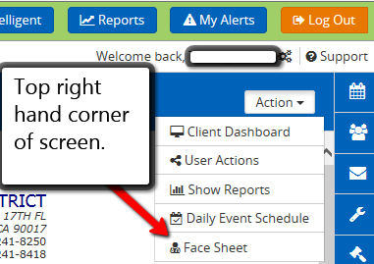
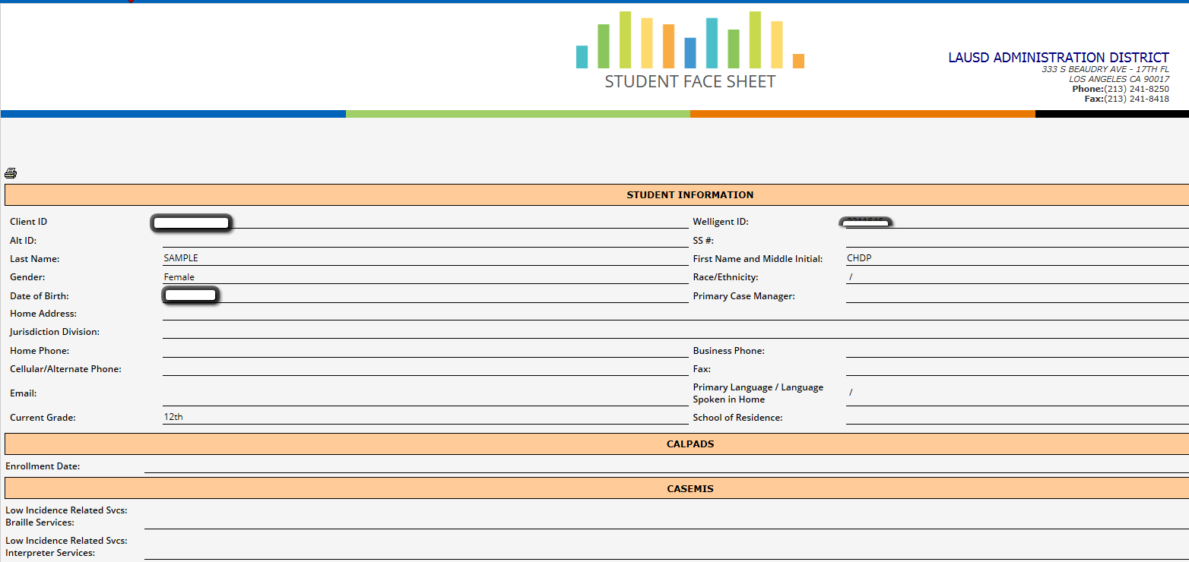
Student Face Sheet

Slide 62

Record Navigator Tabs
The icons below are located on the left hand side of the screen. Hover your mouse over them so that the icon will expand.
Record Navigator
Student Information
Assessments
Case Management
Class Enrollment
IEP Event Listing
Program History
Services
Notes:
The icons listed above are located on the left hand side of the screen. Hover your mouse over them so that the icon will expand.

Slide 63
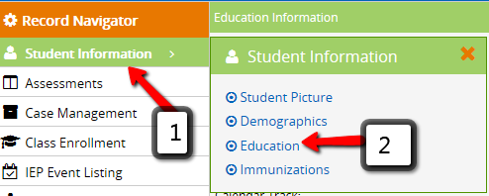
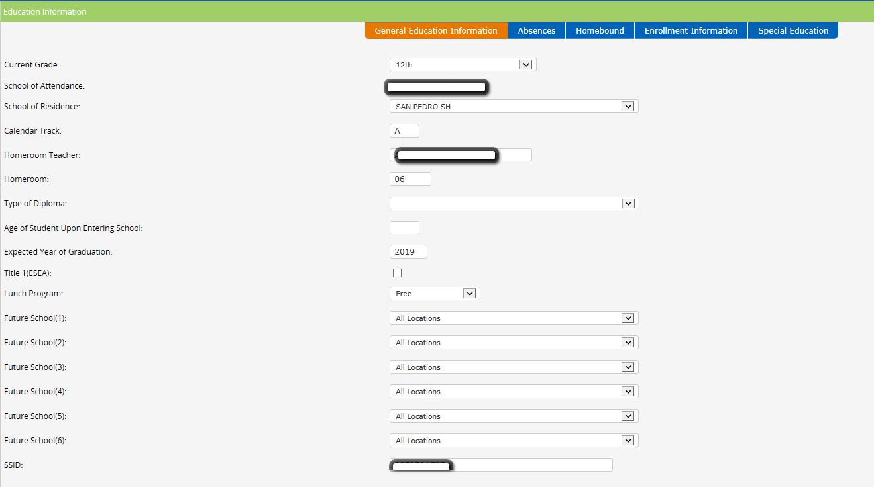
Student Information
Education

Slide 64
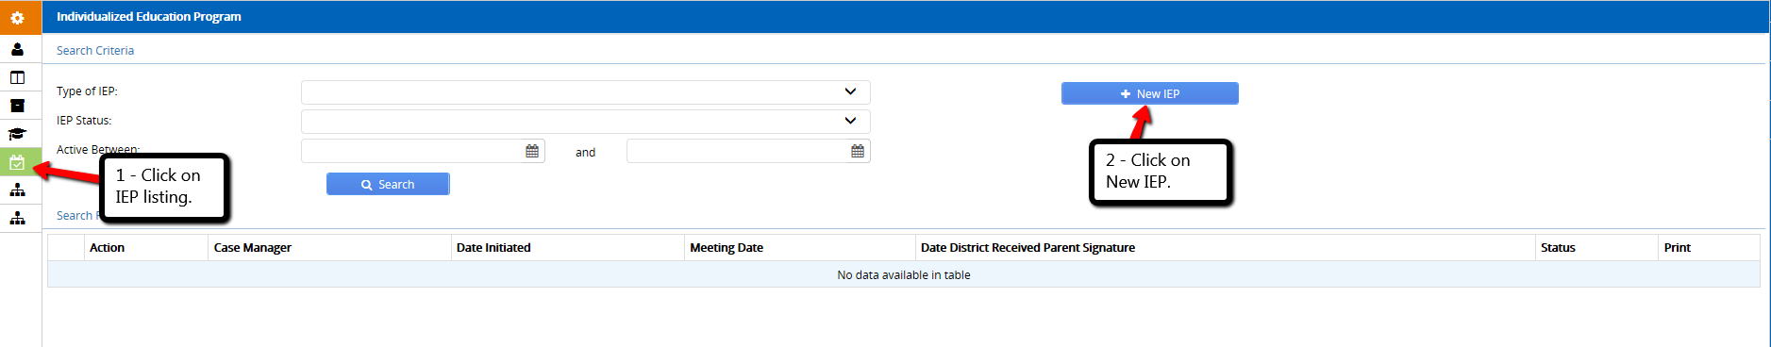
Create New IEP
Notes:
To create a new IEP, click on the “New” tab.

Slide 65
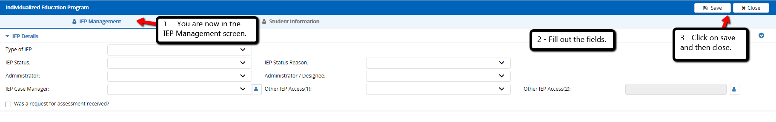
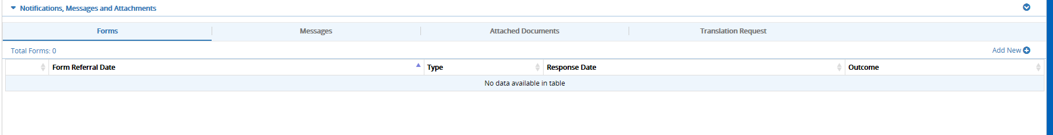
IEP Management Screen
You will receive a message that the referral detail has been successfully inserted (click on ok) and a new screen will pop up below the above screen.
Notes:
Once you click the New (IEP) you are taken to the IEP Management Screen.
Fill out the fields using the drop down menus.
From the drop down menu indicate the “Type of IEP”
From the drop down menu indicate the name of the “Administrator”
From the drop down menu indicate the “ IEP Case Manager”
From the drop down menu indicate the “Status” (In Process)
Remember to click on SAVE and then CLOSE.

Slide 66
Developing an Assessment Plan
A special education assessment plan is to be developed and provided to the parents:
  Within 15 calendar days from the date the receipt of a written request for an initial special education assessment.
  Within 15 calendar days from the date of receipt for an assessment of a student currently receiving special education and related services.
  Prior to conducting a reassessment of a student receiving special education and related services.
  When a change in a student’s eligibility for special education or related services is being considered.
Pages 26, 27 and 31
Notes:
Let’s review when to develop an Assessment Plan:
A special education assessment plan is to be developed and provided to the parents:
Within 15 calendar days from the date the receipt of a written request for an initial special education assessment.
Within 15 calendar days from the date of receipt for an assessment of a student currently receiving special education and related services.
Prior to conducting a reassessment of a student receiving special education and related services.
When a change in a student’s eligibility for special education or related services is being considered.

Slide 67
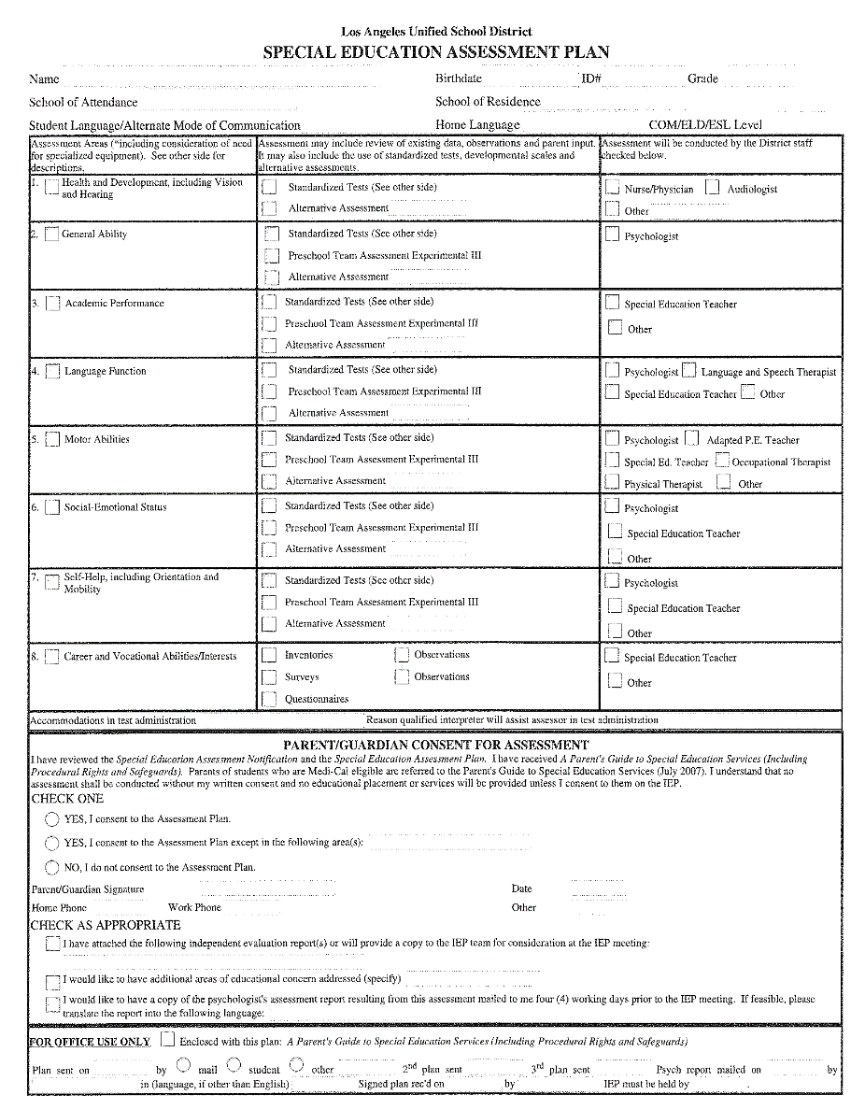
Assessment Plans
Assessment plans are needed for:
  Initial
  Three Year Review
  Re-evaluation
  When considering adding/removing DIS services (ex. OT, LAS, APE, etc.)
Notes:
Assessment Plans are needed for the following types of IEPs: Initials, Formal Three Year Reviews, Re-evaluations, and when considering adding or removing a related service such as Speech and Language, Physical Therapy, Adapted PE.

Slide 68
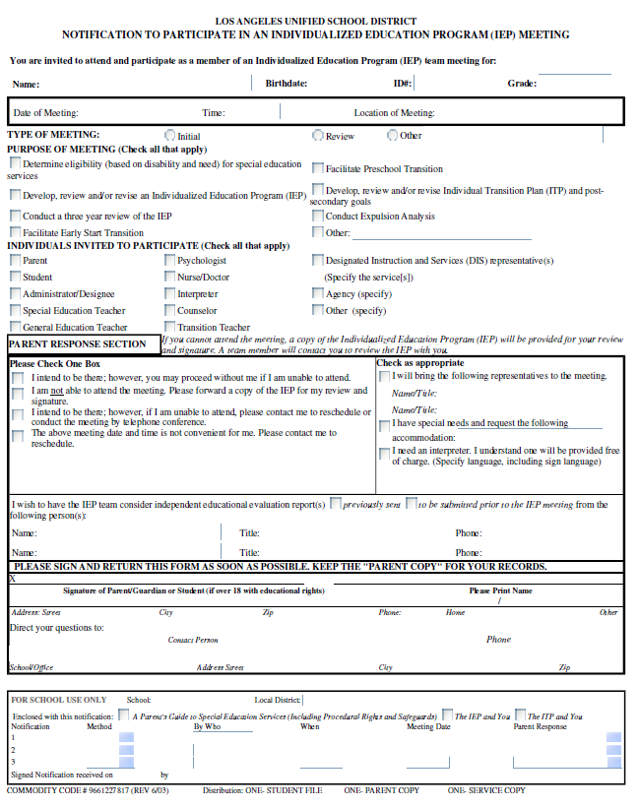
Notification to Participate in an IEP Meeting
  A Notification must be sent out at least 10 days in advance of an IEP.
  If the parent/guardian isn’t present, and there is no signed notification with permission to proceed, the meeting must be postponed.
  When the IEP Notification is returned, it must be entered and uploaded into the Welligent system. Participants must be notified.
See District Policy- REF 6672.0 New Individualized Education Program (IEP) Team Meeting Requirements – Spring 2016
Notes:
From Ref 6672.0:
“Change in Placement” is now an option on the Notification to Participate in an Individualized Education Program (IEP) Meeting form. It is listed under the Purpose of the Meeting section. If the IEP meeting has been scheduled to discuss a change in placement, the “Change in Placement” checkbox must be selected.
Remember that this notification goes out to the parent at least 10 days prior to the scheduled meeting.
Note whether or not the parent will need any reasonable accommodations to access the IEP meeting or need an Oral Interpreter..
Scan an upload the signed IEP Notification to the applicable IEP in the Management. Document all applicable dates and correspondences.
Let’s take a look at how to generate it on Welligent on the next few slides.

Slide 69
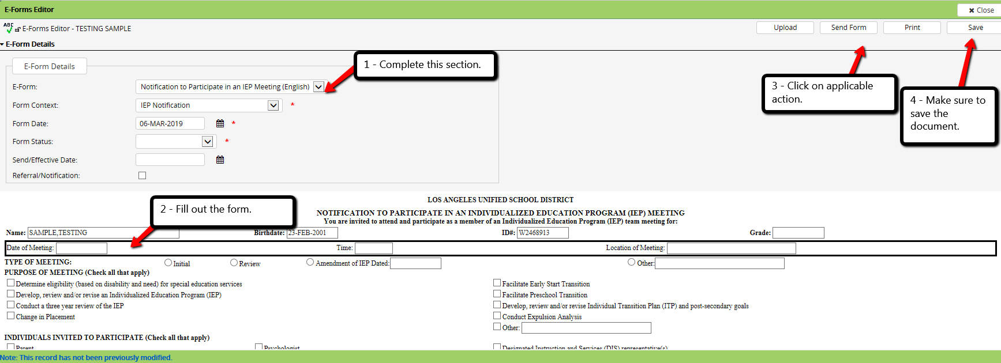
Notification to Participate in an IEP
The following screen will appear:
Notes:
(Refer to directions/reminders in text boxes.)

Slide 70
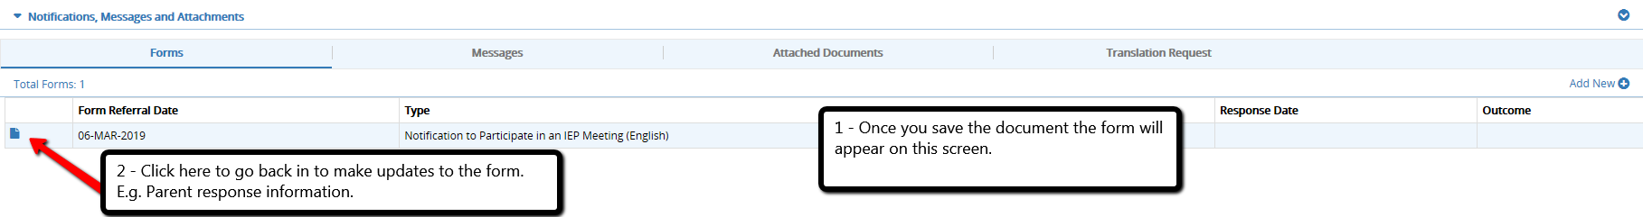
Notification to Participate in an IEP
(Continued)
Notes:
(Refer to text boxes.)

Slide 71
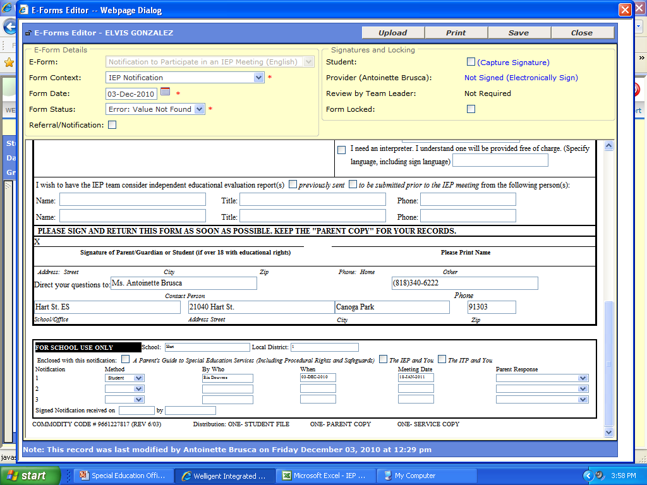
Document Communication on Bottom of Notification Form- Complete all information
Your School’s Name
Your Name Here
Notes:
All three lines must be filled out completely. If a parent does not respond the first time, an IEP can still be held, but only if you have sent out three notifications and documented them (Consult with Administrator on generating 3 Date Letter).

Slide 72
Additional IEP Management Welligent Tasks

Slide 73
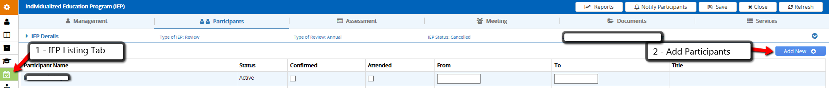
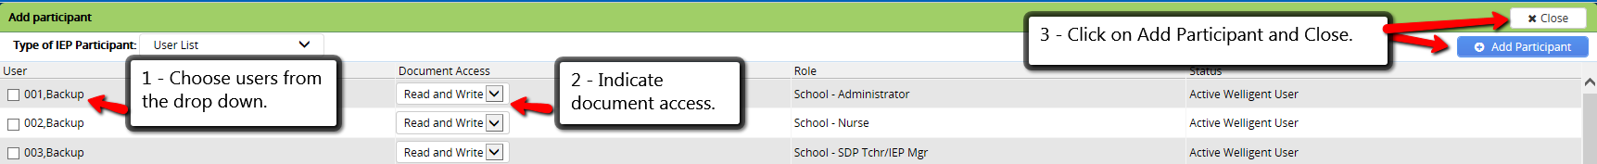
Adding Participants
Add New Participants Pop Up Screen

Slide 74
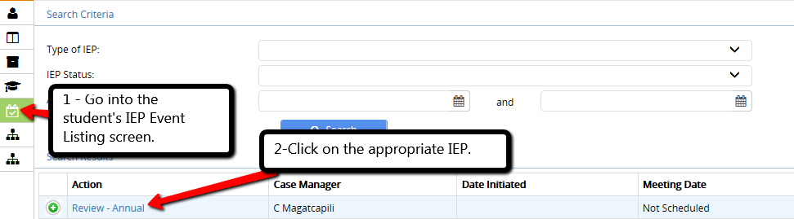
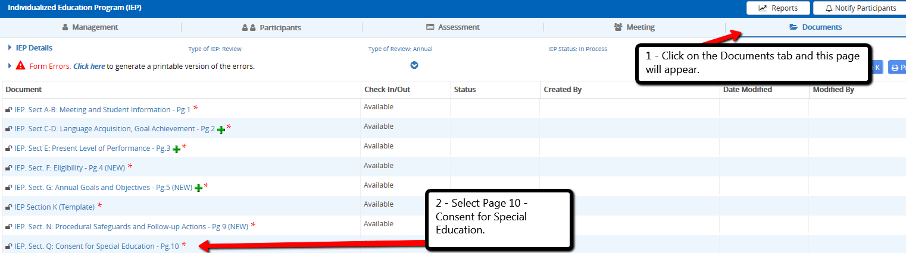
Documenting Consent to the IEP
The following page will appear:

Slide 75
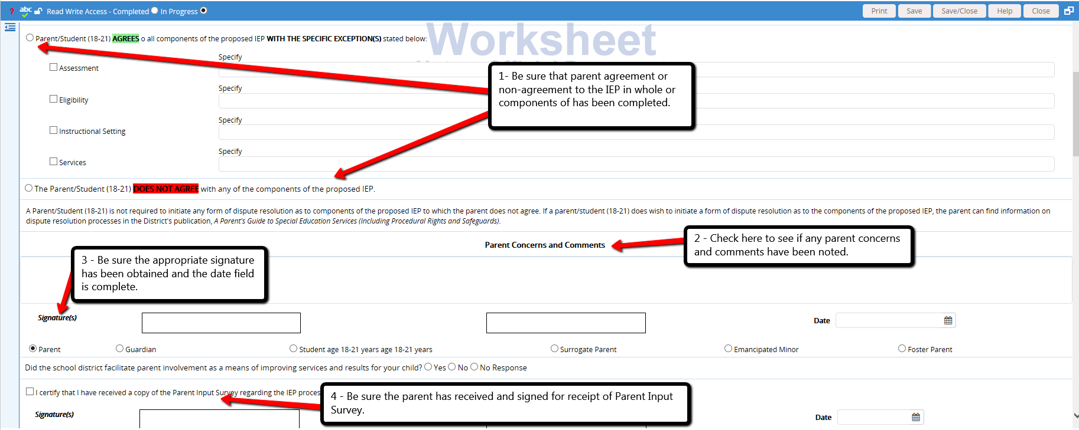
Documenting Consent to the IEP
(Continued)

Slide 76
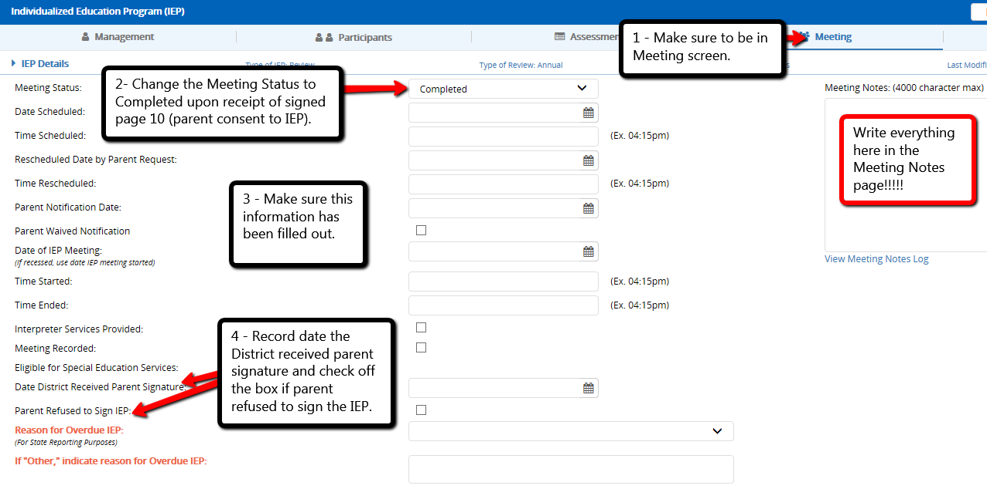
Meeting Screen
See Event Listing Tab and Meeting Screen

Slide 77
The Welligent IEP

Slide 78
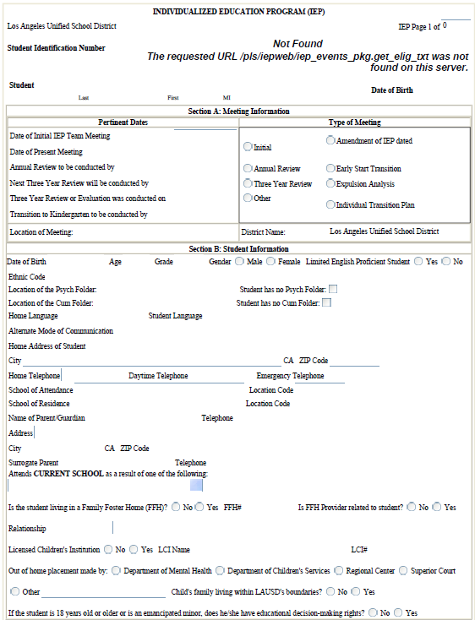
The Welligent IEP
Notes:
(Please refer audience to the sample IEP document that is in their packets. )
Content of the IEP
Assessment or evaluation information for a child with a disability must identify each of the child's educational needs that result from the disability, provide baseline information and describe how the disability affects the child’s participation and progress in the general education curriculum (or for preschool children, appropriate activities). Utilizing baseline data established in the present levels of academic achievement and functional performance the IEP team must develop measurable annual goals, including academic and functional goals that meet the child’s needs and enable the child to be involved in and make progress in the general education curriculum. The special education, related services, supplementary aids and services, program modifications, and supports for school personnel described in the IEP must reflect the child's needs in order to ensure he or she receives educational benefit.

Slide 79
Content of the IEP
Evaluation information for a child with an disability must identify each of the child's educational needs that result from the disability, provide baseline information and describe how the disability affects the child’s participation and progress in the general education curriculum (or for preschool children, appropriate activities)
Utilizing baseline data established in the present levels of performance the IEP team must develop measurable annual goals, including academic and functional goals that meet the child’s needs and enable the child to be involved in and make progress in the general education curriculum.
The special education, related services, supplementary aids and services, program modifications, and supports for school personnel described in the IEP must reflect the child's needs in order to ensure he or she receives educational benefit.
Notes:
(Speak to the slide- Ensure participants have taken out their sample IEP handout and are ready to proceed through the various sections).

Slide 80
Section A: Meeting Information
Pertinent Dates
  One Initial IEP
Type of Meeting
  Initial
  Annual Review
  Triennial (3yr) Review
  Other (30 day, Re-evaluation)
  Early Start Transition
  Expulsion Analysis
  Individual Transition Plan
  Amendment of IEP dated ______
    Amend to date of previous IEP to modify supports and services. Placement changes require an annual review IEP meeting.
Reconvene
  Do not change IEP date (REF 6672.0)
Notes:
PRESENTERS SHOULD REFER TO SAMPLE IEP DOCUMENT IN NEW TEACHER HANDOUTS.
Pertinent dates
Verify all information in this section for correctness
Only one initial IEP date
Annual date is one calendar year from the present meeting date; 3-year date is three calendar years from the initial or last 3-year date; these two dates may be out of sync
Can hold IEP earlier, never later
Type of meeting
Only one box can be checked
Amendment – generate new IEP; use page 1 and other pages as needed; do not change annual or 3-year dates; amend to the date of the base IEP
Reconvene – continuation of an IEP meeting which had to end before it could be completed (time constraints); do not close and lock this IEP since the meeting has not been completed yet
MAKE SURE TO INCLUDE NEW IEP TEAM REQUIREMENTS _ 6672.0 Publication
Reasons for a RECESS – add separate slide

Slide 81

Section B: Student Information
Verify Current Information
  School of Residence/Attendance
  Out of Home Placement
    Educational decision-making rights
    Parent or Surrogate
    Homeless students- refer to BUL-1570.2
Notes:
Verify all information, especially school of residence and school of attendance
Most fields are auto-populated from student information system. Please ensure accuracy of address and parent contact information.
Out-of-Home placement
Need to investigate who has educational rights to represent the student in an IEP meeting
May need a surrogate parent
Surrogate parent – represents the student at the IEP meeting when child is living in an LCI, FFH, or when parent cannot be located; trained by the District
Homeless students- See BUL 1570. 2
Be sure to answer all of the questions at the bottom of this section
Indicate Location of Psych/Cum files (Your Special Education ESC)

Slide 82
Section C: Language Acquisition
Language Classification/Date
Parent Waiver
ELD/Date
Reclassification/ Date
This section documents English Learner status and ELD instructional levels.
Stay updated with the latest District policies by going to MyLAUSD:
  KEYWORD: English Learners
Notes:
Language classification and parent notification information prepopulates in this section and is pulled from MiSiS
Non-Connected Schools (i.e. Charter Schools and Non-Public Schools) without MiSIS access will have to verify information with student records
See BUL-6266.0 for Long Term English Learner guidelines for students in grades 6-12

Slide 83

Section D: Goal Achievement from Current IEP
Indicate Performance Area
“Yes” - Objectives and/or Goals Met
“No” - State Reason
Notes:
If the IEP is an initial, type “NA”
Be brief and professional with your comments
“Student made progress but no mastery.”
“Student’s behavior interfered with goal progress.”
“Student’s lack of participation and completion of work interfered with goal attainment.”
It is possible to meet both objectives, but not the overall goal

Slide 84
Section D: Evaluating Annual Goal Achievement
Good rationale
Inappropriate rationale
“Can recall details in 1 out of 5 trials”
“Can write sentence with modeling”
“Can do with direct assistance”
“Can do with 50% accuracy”
“Can do with text at independent reading level”
“Needs more time”
“Goal written too high”
“Not observed”
“Not appropriate goal”
“Cannot do independently”
“Cannot do consistently”
What are the differences between the good and inappropriate rationale statements ?
Notes:
Take a look at the rationale statements. You want to be as behaviorally as descriptive as possible.

Slide 85
Assessments and Writing the Present Levels of Performance

Slide 86
Conducting Assessments
Produce a stand-alone report whenever an assessment area is marked on the Assessment Plan.
Remember to complete all reports prior to the 60 day timeline:
  Parents have a right to request a copy in advance of the IEP meeting (4 days).
Manage your time so that assessment findings can be summarized, PLPs written and goals /objectives drafted.
  .

Slide 87
Standardized Assessment
What is it?
What is it not?
A method of comparing a student to a national sample of their same-age peers
Very specific administration guidelines
An indicator of a student’s performance under optimal conditions
Only one piece of the puzzle
The best way to measure student performance in all situations
A progress monitoring tool
The only way to determine special education eligibility
A useless number that no one really understands

Slide 88
When do I use the WJIV?
To complete the academic assessment for initial IEPs, re-evaluation IEPs, and triennial three year IEPs
Triennials without comprehensive psycho-educational assessments
  Still require health and academic assessment (See BUL 6639.0 Three-Year Review)
Remember, you need a signed assessment plan before you begin testing.
Notes:
BUL 6639.0 Three-Year Review Individualized Education Program (IEP) Psycho-Educational Reassessment Requirements – guidelines for determination of need for psycho-educational assessments

Slide 89
But what about the KTEA?
What about the WJIII?
Formal, standardized norm-referenced assessments are administered as part of the process of obtaining multiple assessment measures for initial, re-evaluation, and triennial IEP assessments.
It is best practice to use the most recent edition of any standardized, norm-referenced assessment; therefore, it highly recommended that schools purchase any newly normed standardized assessment tool within one calendar year of publication.
Notes:
Explain that there is no rule for when to give which assessment. There isn’t a guideline for students in SDP settings vs. RSP settings.
The WJIII came out in 2001
The WJIV came out in 2014
The KTEA 2 came out in 2004
The KTEA 3 came out in 2014, but at this time, the district does not offer training on it.
All tests were normed on national samples. However, according to the publishers, it is a best practice to move over to the newest version of the test within 1 year of it’s publication, as the new tests are stronger indicators of student’s abilities.

Slide 90
Achievement Tests
Standard Battery
Extended Battery
Test 1: Letter-Word Identification
Test 2: Applied Problems
Test 3: Spelling
Test 4: Passage Comprehension
Test 5: Calculation
Test 6: Writing Samples
Test 7: Word Attack
Test 8: Oral Reading
Test 9: Sentence Reading Fluency
Test 10: Math Facts Fluency
Test 11: Sentence Writing Fluency
Test 12: Reading Recall
Test 13: Number Matrices
Test 14: Editing
Test 15: Word Reading Fluency
Test 16: Spelling of Sounds
Test 17: Reading Vocabulary
Test 18: Science
Test 19: Social Studies
Test 20: Humanities
Notes:
90
90
There are two WJIV Easels– one for the Standard Battery, one for the Extended Battery
Teachers will primarily use the Standard Battery Easel, but should know that other tests are located in the Extended Battery.
Tests 1-6 are the core set of tests. Tests 1-3 can be used to create the Brief Achievement cluster.
Have one participant read the Standard Battery Tests, and one Read the Extended Battery Tests.
Note: These are not called “sub tests.” They are simply “tests.”

Slide 91
Which Tests Shall I Administer?
Always administer 1-6 and 9-11
Consult with the school psychologist to determine if any additional tests are necessary (especially from the Extended Battery)
Notes:
These are the tests that we must give to have a comprehensive, defensible assessment.
The only tests in the Standard Battery that are skipped are (7) Word Attack and (8) Oral Reading.

Slide 92
Clusters and Tests
Broad Reading | Broad Mathematics | Broad Written Language
Letter Word Identification (4) Passage Comprehension (9) Sentence Reading Fluency | (2) Applied Problems (5) Calculation (10) Math Facts Fluency | (3) Spelling (6) Writing Samples (11) Sentence Writing Fluency
Notes:
To show in another way…
Remember, in LAUSD, we typically give 1-6, and 9-11.. More if you can justify.
Testing in fewer test areas might land you in court.

Slide 93
Adding Tests
Adding the test…. | Yields a score for…
(7) Word Attack very similar to DIBELS Next Nonsense Word Fluency [NWF] | Basic Reading Skills
(7) Word Attack AND (16) Spelling of Sounds | Phonemes and Graphemes Cluster
(8) Oral Reading | Reading Fluency
Notes:
You must give the basic battery when administering the WJIV for a defensible assessment. You are free to add more at your discretion if you can justify your reasoning.

Slide 94
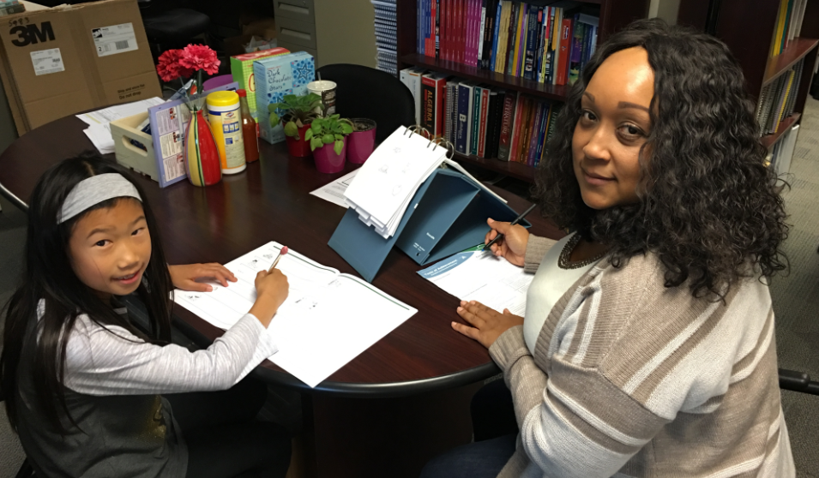
Testing Administration
Read the script
Test one-on one
Use a well-lit, quiet room
Watch facial expression and tone
Establish and maintain rapport
  Praise effort, not performance!
Test in sections if needed
Remember: your task is to help get the best possible performance out of the student
Notes:
Use your energy to motivate the student! They should leave the test feeling better about themselves than when they came to you. The better you are as a tester, the higher their score will be. It is your job to get the highest possible score from the student.
Know purpose of testing
Strive for exact & brisk administration
Allow adequate time for testing
Have necessary materials
(test booklets, test record, subject response booklet, tape, tape player, headphones, pencils, stopwatch)
Establish Rapport
Evaluate behavior during testing

Slide 95

How to Interpret Scores
Standard Score Range | WJ IV Classification
131 and above | Very Superior
121 to 130 | Superior
111 to 120 | High Average
90 to 110 | Average
80 to 89 | Low Average
70 to 79 | Low
69 and below | Very Low

Slide 96

Raw Score
Number of correct responses
Essential to obtaining accurate results

Slide 97
Why don’t we use Grade (GE) or
Age Equivalents (AE)?
GE compares a student’s performance on grade level material against the average performance of students at other grade levels on that same material
If a 5th grader obtains a GE of 10.5, it does not mean the child is solving 10th grade problems. It means they can solve 5th grade problems as well as the average 10th grader
Same goes with AE
Notes:
Because there is so much misinformation about Grade and Age Equivalents, we do not use them. Instead, we use the standard scores, and the descriptors (very low, low, low average, average, high average, superior, and very superior).
Age Equivalents and Grade Equivalents DO NOT drive the results of the WJIV assessment.

Slide 98
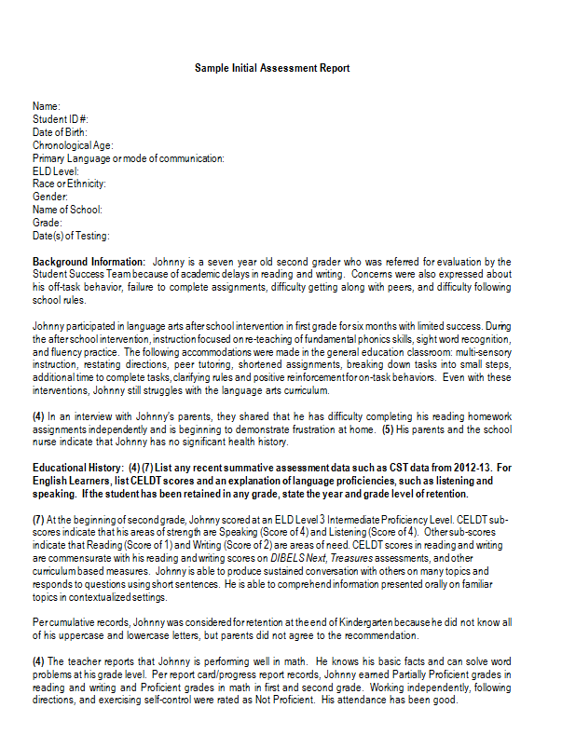
Assessment Reports
In addition to the Welligent documents, assessment reports are uploaded for each area assessed. Follow the template with the required elements and upload to Welligent at least 4 days before the IEP.
Notes:
Review slide.
Have participants refer to the handout- Sample Assessment Report and Required Elements . Encourage them to use this assessment report template. Show where the required components are within the report.

Slide 99
Assessment Report Required Elements
(1)Tests given were valid for student’s evaluation
(2)Test results were a valid reflection of student's skills and aptitudes
(3)If interpreter was used, a statement regarding validity of assessment
(4)Use of multiple assessment measures
(5) Educationally relevant health, development, medical findings
(6) Relevant behavior noted during observation of student in an appropriate setting and relationship of that behavior to student’s academic and social functioning
(7)Results of tests (including primary language tests) administered
(8)Whether student may need special education/related services
(9)Basis for making this determination
(10)Determination concerning effects of environmental, cultural or economic disadvantage
(11) (For psychologist's report only)
(12) (For students with low incidence disabilities only) Need for specialized services, materials and equipment
Notes:
There are the 12 required statements to be included in all assessment reports. Only (11) can be left off of an academic report.
(REFER AUDIENCE TO SAMPLE TEMPLATE IN THEIR PACKET OF HANDOUTS)

Slide 100

A Note About Assessment Report Templates….
Make sure to double check everything before assessment report is uploaded (pronouns, names).
Make each report unique/individualized
  This applies to everything, including the background information, educational information, student observation, test information, and summary and conclusions

Slide 101

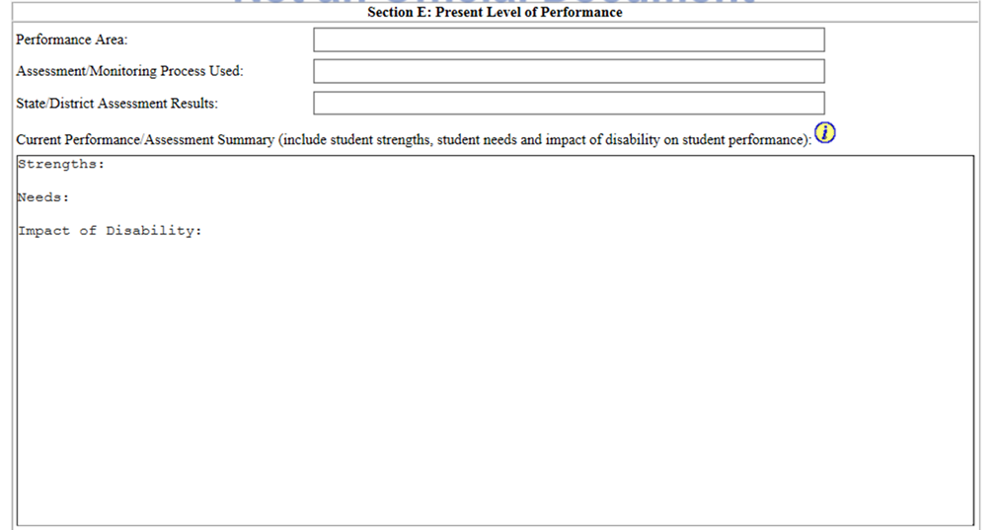

Section E: Present Level of Performance (PLP)
THREE REQUIRED ELEMENTS
Strengths
Area(s) of Need
Impact of Disability
The “heart” of the IEP.
Notes:
The Present Levels of Performance are the “heart” of the IEP. This section will drive the IEP recommendations and ultimate offer of FAPE. It must be based on assessment data, and include input from the parent and general education teacher(s).
Information written in the PLPs will drive what goals and objectives are developed
NOTE: beware of scrollbar and how it affects printout

Slide 102
Writing the Present Level of Performance (PLP)
Remember, the PLPs are in “draft” form and can be changed at an IEP meeting
Summarize information from the assessment report for the specific performance area.
Use multiple measures of assessment
Notes:
Review the “draft” nature of an in process IEP.
Remind the participants that they are not to fill out FAPE 1 or FAPE 2 before the IEP meeting, as that would be PREDETERMINATION (not good).
As mentioned on the assessment plan, families can request the assessment reports and draft PLP pages up to 4 days in advance of the IEP meeting. So, there should be a draft PLP done 4 days ahead of time. Feel free to modify the PLP during the IEP meeting.
Remind participants that we are not to cut and paste scores from the assessment report into the PLP. There should not even be a mention of age or grade equivalents in the PLP (or even grade level on another test). Instead, use the phrasing we use in the WJ score report

Slide 103
Use of Multiple Measures of Assessment to Determine Unique Needs
Curriculum Based Measures | Diagnostic | Curriculum Based Assessment | Summative
DIBELS One minute fluency measures Maze Measures Aimsweb | - CORE Multiple Measures Math diagnostic assessments Words Their Way | Essays Textbook/ publisher tests Teacher made tests Homework Classwork | SBAC IAB Woodcock- Johnson IV ELPAC

Slide 104
Writing the PLPs and Reviewing with the Parent(s)
Complete name of assessment tool used should be included rather than acronyms, i.e. NWF Nonsense Word Fluency
Parent(s) encouraged to provide feedback and comments should be documented as “Parent reports that ________”.
Parents should be participating in the meeting, especially when provider or teacher is reporting on their child’s performance. They know their children best. IEP teams should ensure that parents feel as if they are equal participants in this process.
Make information understandable.
Notes:
Review best practices

Slide 105

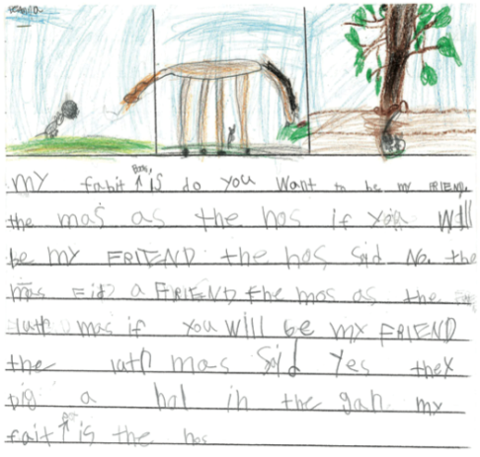

Other Measures/Sources of Student
Data
Student work samples and artifacts
Student discourse and discussion
Teacher and parent observation
Document feedback/Add to PLP

Slide 106
PLP Areas for Students on General Education Curriculum
May be written in following areas:
  Reading
  Writing
  Math
  English Language Development
  Career and Transition
  Behavior
  Related Services, as necessary
Notes:
IEP goals for students instructed in the general education curriculum may be written in the areas noted on the slide
Goals are only written in areas in which the student’s disability is impacting his/her ability to participate and make progress in the grade level curriculum
For children ages 14 and older (or younger if appropriate), the PLPs also describe the child’s transition needs in the areas of education/training, employment and where appropriate independent living skills.
If the student is performing within grade level expectations in a particular performance area, a goal should not be written in that area
Goals for related services are written, as necessary, for the student to benefit from his or her educational program

Slide 107
PLP Areas for Students Instructed with the Alternate Curriculum
Mandatory Goal Areas
  Functional Math
  Functional Reading
  Functional Writing
  Communication
Student Specific Goal Areas
  Career/Transitionl
  Social/Emotional
  Self Care/Independent Living
  Motor Skills/Mobility
  Recreation/Leisure
Related Services, as necessary
Notes:
IEP goals for students instructed in the alternate curriculum must be written in the first four areas noted on the slide
Additional goals may be written to address specific needs resulting from the student’s disability
As previously stated, goals for related services are written, as necessary, for the student to benefit from his or her educational program

Slide 108
PLP Areas for Preschool Curriculum
Students May Include:
1. Social Emotional
2. Physical
3. Communication/Language
4. Cognitive Development
5. Literacy
6. Mathematics
7. Health and Development
8. School Readiness
9. Adaptive behavior/Self-Help
Notes:
For preschool children, the PLPs describe how the disability affects the child's participation in appropriate activities. The term “appropriate activities” includes activities that children of that chronological age engage in as part of a preschool program or in informal activities. Examples of appropriate activities include social activities, pre-reading and math activities, sharing-time, independent play, listening skills, and birth to 6 curricular measures. Federal regulations at 34 C.F.R. 300.323(b) indicate that preschool programs for children with disabilities should have an educational component that promotes school readiness and incorporates pre-literacy, language, and numeracy skills.

Slide 109
Related Services
Audiology Services
Behavior Intervention Therapy
Counseling Services
Health and Nursing Services
Language and Speech Therapy
Occupational Therapy
Orientation and Mobility Services
Physical Therapy
Psychological Services
Rehabilitation Counseling Services
Social Work Services
Transportation

Slide 110
Related Services – Performance Area headers
OT and PT
LAS and APE
REC Therapy
Occupational Therapy
  Sensorimotor
  Fine Motor
  Visual Motor
  Visual Perceptual
  Social Participation
  Activities of Daily Living
Physical Therapy
  Gross Motor
  Mobility
  Physical Accessibility
Recreational Therapy
  Recreation Behavior
  Independent Recreation Involvement
  Social Functioning
  Leisure Education
  Adaptive Behaviors
Language and Speech
  Voice
  Fluency
  Articulation
  Language – 3 sub areas
  Communication
Adapted Physical Education
  Perceptual Motor
  Locomotor
  Object Control
  Physical Fitness
  Adaptive Behaviors

Slide 111
Considerations of the IEP Team
The IEP team should consider the following questions when writing the PLPs:
  In areas of concern, what is the child's present level of performance in relationship to district standards and benchmarks in the general education curriculum (or to the extended standards)?
  In areas of concern, what is the child's present level of performance in relationship to level of performance that will be required to achieve the postsecondary goals?
  Are there functional areas of concern related to the disability not reflected in the general education curriculum (e.g., self-care skills, social skills, classroom survival, etc.)?
  What is the degree of match between the skills of the child and the instructional environment?
  What strengths of the child are relevant to address the identified concerns?

Slide 112
Section E: Present Level of Performance (PLP)
THREE REQUIRED ELEMENTS
Strengths
Area(s) of Need
Impact of Disability
Notes:
The Present Levels of Performance are the “heart” of the IEP. This section will drive the IEP recommendations and ultimate offer of FAPE. It must be based on assessment data, and include input from the parent and general education teacher(s).
Information written in the PLPs will drive what goals and objectives are developed
Baseline data provides the starting point for each measurable annual goal, so there must be one baseline data point for every measurable annual goal on the child’s IEP. Baseline data in the _PLPs are derived from locally developed or adopted assessments that align with the general education curriculum. Examples of baseline data include percent of correct responses, words read correctly, number of times behavior occurs, and mean length of utterances. Other issues important in collecting baseline data are the understanding that any goal written will have the same measurement method as was used in collecting its baseline data. Also, when selecting baseline data, it needs to be (a) specific –to the skill/behavior that is being measured, (b) objective –so that others will be able to measure it and get the same results, (c) measurable –it must be something that can be observed, counted, or somehow measured, and (d) able to be collected frequently –when progress reports are sent out the progress of the student toward the goal will have to be reported using the same measurement method as used to collect the baseline data. Non-examples of this would be self-esteem or social awareness without a more specific description of what it means.
•
NOTE: beware of scrollbar and how it affects printout

Slide 113
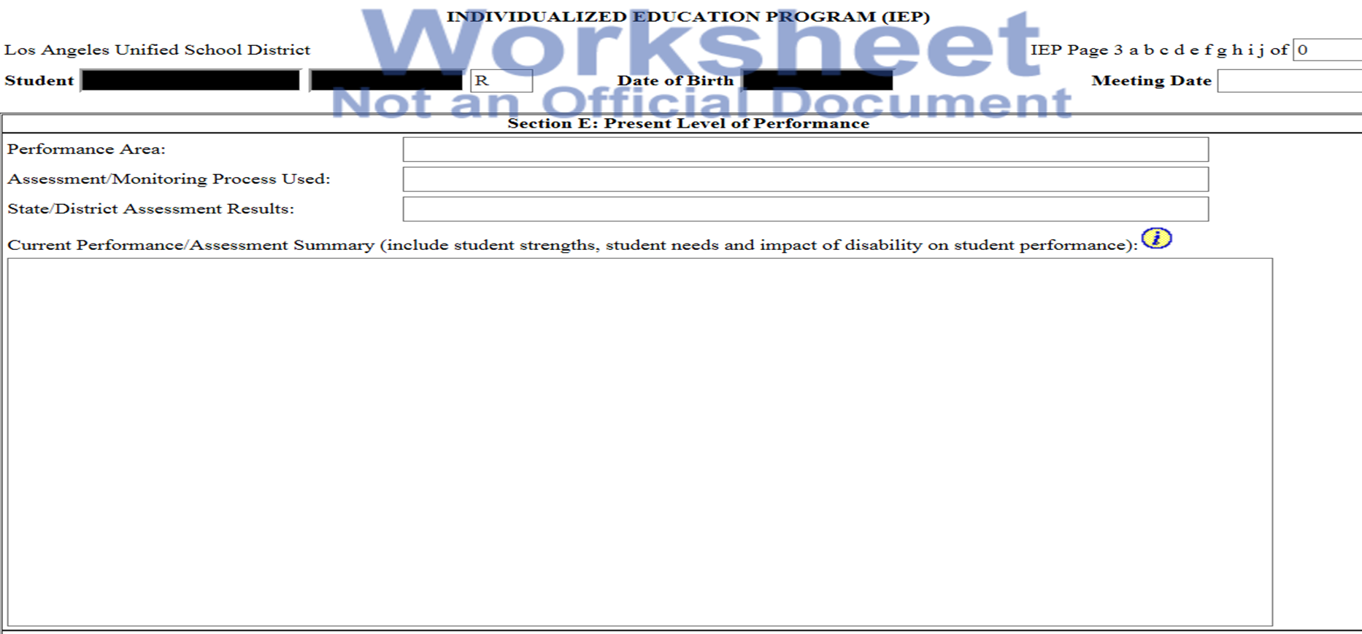
Strengths:
Reflect specific skills or behaviors the student has mastered.
Reflect specific skills in which the student performs well for the domain or area targeted.

Slide 114
Area(s) of Need:
Needs are determined by consideration of…
  The important skills and behaviors that are critical for the student to learn in order to be able to participate and make progress in the general curriculum for the specific performance area.
Needs are addressed through goals, supports and services, and/or accommodations.

Slide 115
Understanding the Impact of Disability Statement:
Convey the unique challenges or barriers that exist for the student as a result of the disability.
Describe how the disability impacts the student’s involvement in the general curriculum.
Describe the impact the disability has on the student’s academic and functional performance in school.
Notes:
Impact of Disability statement must contain these three elements.
State the name of the disability and describe how the disability impacts the student’s academic skills specifically. Then make the connect to the impact to the student’s involvement and progress in the general education curriculum.
Don’t assume that teachers have knowledge of different disabilities. They may not realize that certain demands placed on students may create a barrier for a student. Therefore certain skills may need to be taught (academic or functional). Or specific accommodations or modifications may be needed. The impact may cross content areas and settings. Any class that relies on text-driven assignments will have an adverse effect on the student with a reading disability. So reading assignments written on the board, reading questions on a written exam, etc. this should be explicit in the IEP.

Slide 116
Required Elements of the
Impact of Disability Statement:
Name the disability/( IEP eligibility)
Describe how the disability impacts the student in the specific performance area
State that the disability impacts the student’s involvement and progress in the general education curriculum
Notes:
Impact of Disability statement must contain these three elements.
State the name of the disability and describe how the disability impacts the student’s academic skills specifically. Then make the connect to the impact to the student’s involvement and progress in the general education curriculum.
Note: if the student has a SLD, write SLD, not just “auditory processing”. If you want to include more information about the student’s SLD, the teacher can go back to the most recent 3 year and look at the SLD certification page, then write “Specific Learning Disability in the area of auditory processing,” but this is not a requirement.
Refer participants to handouts- Sample PLPs

Slide 117
What if the Student’s disability does NOT impact this performance area?
Write the student’s strengths as you would with any PLP.
For the impact of disability statement, write that there is no impact of disability in that area at this time.
Remember, there would be no need for a goal for that specific area.

Slide 118
SAMPLE STRENGTHS
STRENGTHS:
  Donald is able to recognize and name numbers to twenty. He is also able to count objects to twenty when they are arranged in a random order. When given counters, Donald is able to add and subtract numbers to ten. Teacher also noted that one to one correspondence is improving.

Slide 119
SAMPLE NEEDS
NEEDS:
  Donald has difficulty with comparing numbers based on their value. He is having difficulty with addition and subtraction of single digit numbers to twenty. He does not demonstrate fluency and automaticity with solving number sentences with a sum up to twenty.

Slide 120
SAMPLE IMPACT OF DISABILITY STATEMENT
IMPACT OF DISABILITY:
  Donald’s Intellectual Disability impairs his ability to fully participate in tasks and activities related to solving math calculations which impacts his involvement and progress in the general education curriculum.

Slide 121
Other Examples of Impact of Disability Statements
Sue’s specific learning disability impairs her ability to read fluently which impacts her involvement and progress in the general education curriculum.
Ben‘s other health impairment impairs his ability to sustain attention during reading which impacts his involvement and progress in the general education curriculum.

Slide 122
Determining the Appropriate Curriculum
Determining whether a student will be instructed with the alternate or general education curriculum
Must be decided for each student by IEP teams based on assessment data reflected in the PLP section(s) of the IEP.
Information presented should clearly support the discussion regarding the recommendation to use the alternate curriculum, if determined appropriate.
Ensure parents understand and participate in a thorough discussion.
Curriculum is documented on FAPE 1 of the IEP.
Notes:
122

Slide 123
Alternate Curriculum Materials
Unique Learning Systems
  REQUIRED curriculum for special day program teachers instructing students instructed with the alternate curriculum
  Research-based English language arts, math, science and social studies curriculum specifically designed for students with moderate to severe disabilities
  Features monthly thematic units aligned to Common Core State Standards (CCSS)

Slide 124
Developing ELD PLPs and Linguistically Appropriate Goals
The IEP team may not recommend that an EL “waive” or “opt out” of ELD instruction or enrollment in an ELD course or program.
English Learners (EL) require English Language Development instruction as part of their IEP.
This is a federal requirement.

Slide 125
Developing ELD PLPs and Linguistically Appropriate Goals (continued)
Address all four domains of language on the ELD Present Level of Performance
Listening
Speaking
Reading
Writing
See color-coded examples on next slide.

Slide 126
Developing ELD PLPs and Goals (Continued)
Strengths per each language domain:
Listening: Celina can summarize a one minute story told to her.
Speaking: Celina is able to express her wants and needs using phrases and simple sentences. She is able to hold a 3 minute conversation with peers and adults.
Reading: Celina can read simple text with acquired vocabulary. She can retell events and answer questions using simple sentences.
Writing: Celina can complete written assignments using phonetic spelling and acquired vocabulary and language structures.
Notes:
High Point: Day 1
Presenter’s Notes/Slide 126

Slide 127
Alignment of ELD Identified Needs and Goals
State what student can do in objective terms
Determine which language domain requires a goal based on assessment data
More than one goal can be established based on student’s unique needs.
Document how student EL proficiency performance impacts student’s progress toward reclassification

Slide 128
Documenting Behavioral Needs of Students with Disabilities
Every IEP that contains a behavior intervention plan (BIP) must have a corresponding Behavior PLP.
Do not use scores, jargon or acronyms, unless you elaborate/explain each comment.
Detailed description of target behavior(s), including the antecedent and consequence(also include frequency, duration, & intensity).
Consider all classes, settings, times of day and people (e.g., peers, staff, admin., service providers).

Slide 129
Eligibility

Slide 130
Section F: Eligibility
Document Initial, New, and Ongoing Eligibilities
Document Non-Eligibilities
Considerations to Prevent Inappropriate Identification
  Six exclusionary factors
Notes:
On this page you will: (read slide)
“Safety Net” is the 6 boxes at the bottom of the page – if you cannot check all of the boxes, then the student does not qualify for special education services
Exclusionary factors must be considered before determining eligibility
Discuss multiple disabilities
Disability DOES NOT determine placement…that’s the reason you might see various eligibilities in the same classroom

Slide 131
A Note About Eligibility….
Eligibility is an IEP team decision.
One person alone does not determine if a student is or is not eligible for special education services, or what their eligibility may be.
Notes:
Remind participants that for assessment reports, avoid any statements that lead to a perception of predetermination
Remind participants that the “impact of disability” statements should not be put into a draft initial or re-evaluation

Slide 132
Disabilities/IEP Eligibilities
Autism (AUT)
Deaf (DEA)
Deaf-Blindness (DBL)
Emotional Disturbance (ED)
Established Medical Disability (EMD)
Hard of Hearing (HOH)
Intellectual Disability (ID)
  Formerly “Mental Retardation”
Notes:
132
There are 14 disabilities for which a child may be found eligible for special education
Teachers can refer back to the initial IEP and/or psych report to find what is the specific psychological processing deficit

Slide 133
Disabilities (Continued)
Multiple Disabilities (MDH, MDO, MDV)
Orthopedic Impairment (OI)
Other Health Impairment (OHI)
Specific Learning Disability (SLD)
Speech or Language Impairment (SLI)
Traumatic Brain Injury (TBI)
Visual Impairment (VI)
Notes:
133
Developmental Delay (DD) – not to be used for children older than 3 years, 8 months
Primarily used for students referred from Early Start and Regional Center.

Slide 134
Goals

Slide 135
Section G: Annual Goals and Objectives
Drafted Prior to IEP Meeting
  Must be discussed during IEP meeting
  May be revised based on IEP meeting discussion
Indicate Achievement Dates for Objectives
Notes:
Achievement dates for goals

Slide 136
Section G: Annual Goals and Objectives (Continued)
General Education Curriculum
  Goals written at student’s grade level. However, you can write an additional “foundational reading” goal at the student’s ability level
Alternate Curriculum
    Goals written at student’s ability level
Preschool Curriculum
  Goals are written at student’s skill level
Notes:
Goals for students receiving instruction in the general education curriculum must be written to grade level standards
Goals for students receiving instruction in the alternate curriculum should be based on the student’s ability level
Goals for students receiving instruction in the Preschool curriculum should be based on the student’s skill level.

Slide 137
Goals for Students on General Education Curriculum
May be written in following areas:
  Reading
  Writing
  Math
  English Language Development
  Career and Transition
  Behavior
  Related Services, as necessary
Notes:
IEP goals for students instructed in the general education curriculum may be written in the areas noted on the slide
Goals are only written in areas in which the student’s disability is impacting his/her ability to participate and make progress in the grade level curriculum
If the student is performing within grade level expectations in a particular performance area, a goal should not be written in that area
Goals for related services are written, as necessary, for the student to benefit from his or her educational program

Slide 138
Goals for Students Instructed with the Alternate Curriculum
Mandatory Goal Areas
  Functional Math
  Functional Reading
  Functional Writing
  Communication
Student Specific Goal Areas
  Career and Transition
  Social/Emotional
  Self Care/Independent Living
  Motor Skills/Mobility
  Recreation/Leisure
Related Services, as necessary
Notes:
IEP goals for students instructed in the alternate curriculum must be written in the first four areas noted on the slide
Additional goals may be written to address specific needs resulting from the student’s disability
As previously stated, goals for related services are written, as necessary, for the student to benefit from his or her educational program
Vocational Ed goal: The purpose of Pre-Vocational Goals is to help train children in specific measurable skill building tasks. For some, the ability to organize, plan or stay on task in class does not come naturally to them. Pre-Vocational Goals can help a student learn how to master these skills so that when they enter middle school, they will be prepared to deal with an environment that no longer holds their hand and tells them what to do every minute in class.

Slide 139
Goals for Students on
Preschool Curriculum
Mandatory Goal Areas
  Cognitive
  Motor
  Social Emotional
  Language
Notes:
Talk to the slide

Slide 140
Goals for Related Services for Eligible Students
Adapted Physical Education
Audiology Services
Counseling Services
  Psychological Services/ERICs
Language and Speech Therapy
Occupational Therapy
Orientation and Mobility Services
Physical Therapy
Notes:
Goals for related services may include, but are not limited to, the services noted on the slide

Slide 141
How do we know which goals to write in an IEP?
Present Levels of Performance
  What student has learned
  What student needs to learn
Goals Developed to Address Student Needs Identified in PLPs
Notes:
PLPs provide information on what the student has learned and document the standards or skills the student needs to learn
Goals are developed to address the needs that have been identified in the PLPs

Slide 142
What about older students who still need foundational reading skills?
Best Practice is to write two Reading goals
Goal Number One: Address Foundational Reading (FR) out of level
Goal Number Two: Address grade level reading comprehension goal in either Reading Information (RI) or Reading Literature (RL)
Notes:
Best practice to address older students who still need foundational reading addressed:
Write two goals, one out of level and the other one grade level addressing comprehension.
Make sure goals are attainable within one year. Explain to parents that addressing foundational reading skills will improve student’s reading abilities.

Slide 143

Write SMART Goals Aligned to CCSS
Specific
Measurable
Attainable
Relevant
Time-bound
Notes:
The goal is to write SMART goals aligned to the Common Core State Standards:
Specific – not in general terms, but individualized to student needs
Measurable – must be quantifiable and able to be measured. Non-example: Student will understand multiplication.
Attainable given student’s present level of performance
Relevant to student needs. There must be a direct link established between goals and PLP Area of Need.
Time bound – what can realistically be achieved in a year’s time

Slide 144
Section G: Annual Goals/Objectives
Goals and Objectives Contain:
  Who (name of student)
  What (observable behavior)
  Conditions (situation in which behavior performed)
  Accuracy (level of mastery)
  Frequency (how often)
Reading
Notes:
A SMART goal has the following components in it. Speak to the slide.

Slide 145
Sample Annual Goal and Required Elements
When given a 3rd grade text, Spencer will answer factual based questions related to a text read aloud with 90% accuracy 4 out of 4 trials.
  1. Conditions (situation in which behavior performed)
  2. Who (Spencer)
  3. What (observable student behavior)
  4. Accuracy (level of mastery)
  5. Frequency (how often)
Notes:
This goal requires all five components to be included in order to document and measure the student’s level of mastery to be achieved

Slide 146
Sample Annual Goal and Required Elements
Goal: When given a 3rd grade text, Spencer will answer factual based questions related to a text read aloud with 90% accuracy 4 out of 4 trials.
  Objective #1: When given a 3rd grade text, Spencer will answer factual based questions related to a text read aloud with 70% accuracy 3 out of 4 trials
  Objective #2: When given a 3rd grade text, Spencer will answer factual based questions related to a text read aloud with 80% accuracy 4 out of 4 trials
Notes:
The District requires that all goals have two short-term objectives
The CCSS goal bank is available is now available as a drop down in Welligent.
Looking at the objectives for this student, it appears that she is functioning close to grade level and has the prerequisite skills to achieve the goal
The objectives have been developed to assist the student achieve grade level mastery

Slide 147
Scaffolding Goals
Goal: When given a literary text, Maria will list the primary and secondary character traits of the main character with 80% accuracy in 3 out of 4 trials. (9th grade standard)
Objective #1: When given a literary text, Maria will state main idea and evidence that supports main idea with 80% accuracy in 3 out of 4 trials. (5th grade standard)
Objective #2: When given a literary text, Maria will state meaning of specialized vocabulary words with 80% accuracy in 3 out of 4 trials. (7th grade standard)
Notes:
For students in the general education curriculum who are functioning considerably below grade level, objectives have to be scaffolded to address the attainment of prerequisite skills from below grade level standards
One way to conceptualize this task is to think of the goal as addressing grade level instruction and the objectives as addressing intervention instruction
For this ninth grade student, the goal was written at grade level
Prerequisite skills the student required were developed from fifth and seventh grade standards

Slide 148
Prerequisite Skills as Objectives
Goal: When given a teacher made sample of fractions, Brad will convert them to decimals and percentages and create a visual representation with 80% accuracy in 3 out of 5 trials. (7th grade standard)
Objective #1: When given 10 problems involving percents and decimals, Brad will interpret percentages as parts of a hundred, and compute a given percent of a whole number with 80% accuracy in 3 out of 5 trials. (5th grade standard)
Objective #2: When given assorted addition and subtraction problems using positive fractions, Brad will list order of operations to correctly solve each problem with 80% accuracy in 3 out of 5 trials. (6th grade standard)
Notes:
Similarly, for this seventh grade student, the goal was written at grade level
Prerequisite skills the student required were developed from fifth and sixth grade standards

Slide 149
IEP Report of Progress and Achievement From Current IEP
Parents Must Receive Information On How Student Is Progressing Toward Meeting IEP Goals
Frequency of Reporting
  Three times per year – elementary
  Four times per year – secondary
Continued Lack of Progress
  Amend/revise IEP
    Modify or change goals
    Consider change in supports and/or services
Notes:
Provided to parents at the same time that report cards are distributed at the school site
Elementary students -- three times a year
Secondary students -- four times per year
Each school has its own process for distribution of report of progress
Continued lack of progress towards the goals may indicate the need to convene an IEP meeting to change goals, supports, and/or services
Must be updated in Welligent

Slide 150
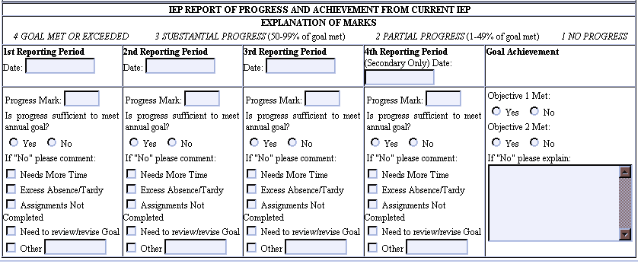
IEP Report of Progress and Achievement From Current IEP (Continued)
Progress is documented in alignment with the “life of the IEP”.
Work from left to right.
Notes:
Always start marking in the first reporting period box (left side of the page) regardless of the report card cycle and move across the page left to right
This first step in reporting progress is the use of the four level marking system
A mark of 4 indicates “Goal Met or Exceeded”, a mark of 3 indicates “Substantial Progress”, 2 indicates “Partial Progress”, and 1 indicates “No Progress”
The second step in reporting progress is to address whether or not progress has been sufficient enough to meet the annual goal
Check either “Yes” or “No”
Any “No” response requires a comment
Check the comment that best explains the lack of progress

Slide 151
State and District Assessments

Slide 152
Section K- Participation in State and District-wide Assessments
Section K is a separate screen that fills in a ‘template’ form.
Tests displayed align to the Student’s grade level requirements per the CDE and LAUSD.
See REF-043786: LAUSD Accessibility and Accommodations Guidelines for Smarter Balanced Assessments
See REF- 044782: LAUSD Accessibility and Accommodations Guidelines for English Language Proficiency Assessments for California Assessments.
Notes:
To maintain compliance with changes in California's statewide testing program, revisions to the IEP Section K have been added to Welligent. A new reference guide, REF-043786: LAUSD Accessibility and Accommodations Guidelines for Smarter Balanced Assessments, has been published to assist IEP teams, Section 504 teams, and educators in selecting appropriate supports for both statewide testing and District-wide testing (i.e., periodic assessments).
Changes to the availability of some designated supports and accommodations for State-wide testing are included in the revised Section K. These changes are associated with the changes to Matrix One: Universal Tools, Designated Supports, and Accommodations for the California Assessment of Student Performance and Progress for 2017-2018 (Revised August 2017).
The CAPA/AA has been replaced by the California Alternate Assessment (CAA) for English, mathematics, and science.
The change from CELDT to English Language Proficiency Assessments for California (ELPAC) was initiated by the state in July 2017. The first administration of the ELPAC Summative Assessment was in Spring 2018. The change from Communication Observation Matrix (COM) to Ventura County Comprehensive Alternate Language Proficiency Survey (VCCALPS) reflects the alignment of alternate English-language assessments to address the four language domains – reading, writing, speaking, and listening. For more information about ELPAC testing accessibility resources, see REF-044782: LAUSD Accessibility and Accommodations Guidelines for English Language Proficiency Assessments for California Assessments. For more information about the new testing requirements, please contact the LAUSD Student Testing Unit at (213) 241-4104.

Slide 153
Reminder
Accommodations/Modifications Used in Testing
  Must be necessary for classroom instructional and/or testing activities
  Must reflect what is used day to day in classroom for student.

Slide 154
Procedural Safeguards
Follow-up & Signature

Slide 155
Section N: Procedural Safeguards & Follow-Up Actions
Parent’s Guide to Special Education Services
IEP Team Meeting Introductory Statements were read aloud at beginning of Meeting
Copies of All Assessment Reports
  Review reports with parents prior to meeting
  Provide reports to parents upon request
Right to Written Translation
Transfer of Educational Decision Making Rights at 18 years of age

Slide 156
REQUIRED IEP Team Meeting Introductory Statements
• An IEP meeting is a collaborative process, and all participants will be provided the opportunity to ask questions and provide recommendations and suggestions;
• The IEP team has the authority and responsibility to design a program in which the child can derive meaningful benefit;
• The draft IEP, behavior intervention plan, or assessment plan might change as a result of the IEP team’s deliberations;
• The decision on related services and placement will occur during the IEP meeting, unless the team agrees that there is not sufficient information to make a placement determination;
• The District considers the family equal partners in the educational decision-making process; and
• Any team member may propose an objective or goal in the IEP, even if it is not included in the Welligent goal bank.

Slide 157
Written Translation of IEP Documents
  The IEP chairperson documents the written translation request on the IEP page 9 and which pages are required.
  Maintain on site documentation of these actions using the “School Log of Translated IEP/504 Documents Provided to Parents” (Attachment B) form of REF- 6349.2
  See District Policy REF- 6349.2 Submitting Requests for Written Translation of Individualized Education Program (IEP) and Related Documents
  Written Translations must be satisfactorily completed and provided to the Parent within 30 calendar days of the request.
Notes:
Parents may request a copy of the IEP in Spanish.

Slide 158
Age of Majority – 18 years
Parents make decisions about the student’s educational program until age of 18.
Parents and students must be informed of this transfer of rights.
  This is documented on the IEP on Section N at least one year before the student turns 18. Discuss with parent.
When the student turns 18, educational rights transfer to the student.

Slide 159
Placement and Supports

Slide 160
LRE Analysis Worksheet
Placement and Consideration of Least Restrictive Environment (LRE)
  Initial placement/change of placement recommended
    Consider all LRE placement options
    Discuss advantages and disadvantages/Harmful Effects section REQUIRED
  If change of placement is not recommended
    Review current placement
    Confirm placement is appropriate

Slide 161
Required LRE Questions to Address in Placement Determinations
Can the needs of the student be met in the educational placement available at the school of residence?
If the needs of the student can be met at the school of residence, are supports, services, accommodations or modifications needed to ensure the environment is effective for the student?
If the educational placement available at the school of residence initially appears not to meet the needs of the student, what supplementary aids and services would make the environment effective for the student?

Slide 162
Required LRE Principles for IEP Teams to Follow
The IEP team must apply the following four basic principles in discussing the supplementary aids and services and educational placement for students with disabilities:
  Special education is a service that students with disabilities receive, not a place where students are sent.
  IEP team determinations, including placement and supplementary aids and services, must be based on the individual needs of the student.

Slide 163
Additional LRE Principles for IEP Teams to Follow
3. To the extent feasible, student supplementary
aids and services to promote learning must be
moved to the student as opposed to the student
moving to the supplementary aids and services.
4. The extent to which students with disabilities are
integrated with their nondisabled peers positively
impacts their educational achievement and their
social growth.

Slide 164
Documenting the offer of FAPE
The offer of FAPE is documented by the IEP team on the IEP.
It is documentation of the District’s recommended program and services to the address the needs of the student.
It must include a specific offer of placement containing the essential factors eligibility, placement and supports in FAPE Part 1.

Slide 165
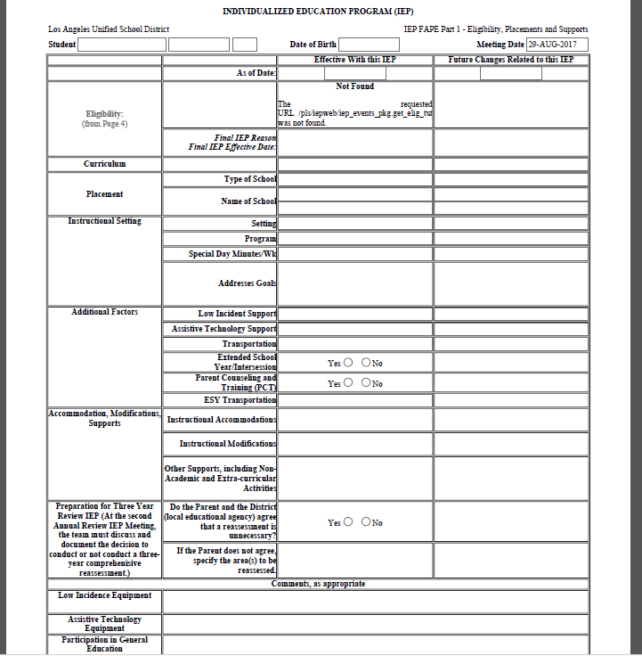
FAPE 1
Complete as determined by the IEP team.

Slide 166

FAPE Part 1 (Continued)
Document:
Eligibility- Fills from page 4
Curriculum
Placement
  Type of School
  Name of School
Instructional Setting
  Setting
  Program
  Special Day Minutes/Wk
  Addresses Goals
Notes:
Talk to the slide

Slide 167
FAPE Part 1 (Continued)
Document:
Additional Factors
  Low Incident Support
  Assistive Technology Support
  Transportation
  Extended School Year/Intersession
  ESY Transportation
Accommodations, Modifications, Supports
Preparation for 3-year Review IEP
Low Incidence Equipment
Participation in General Education
Notes:
Talk to the slide

Slide 168

Accommodations: Definition
“Do not fundamentally alter or lower expectations or standards in instructional level, content or performance criteria”
Simply stated…
  Accommodations are changes to the way students are expected to learn or how they are tested

Slide 169
Example of Learning Difficulty | Example of Accommodation
Copying from board | Preferential seating
Visual/auditory distractions | Study carrel
Finding main ideas | Study guide/highlighted text
Taking notes | Copy of lecture notes
Expressing ideas | Grade content and mechanics separately
Keeping track of assignments | Mark assignments on calendar
Works slower than classmates | Shorten assignment
Confused by complex directions | Color code steps of task
Focusing on test | Overlays to enhance visual field
Notes:
This slide provides an example of the learning difficulty on the left and an example of an accommodation on the right.

Slide 170
Modifications: Definition
“Do fundamentally alter or lower expectations or standards in instructional level, content or performance criteria”
Simply stated…
  Modifications are changes to what students are expected to learn
Notes:
Let’s take a look a “Modifications”. Remember that modifications do alter the standard and change the expectation for the student.

Slide 171
Services

Slide 172
FAPE Part 2
Summary of Services
  A selection of the related service
  The date the service will begin (select from drop down menu)
  Service Applies To
  Frequency
  Interval
  Minutes/Interval
  Minutes/Interval Pullout from General Education
  Service Delivery Model
  Responsible Personnel

Slide 173
FAPE Part 3
The documented offer of FAPE will continue in FAPE Part 3
  Percentage of Time Outside of General Education – this fills automatically for you.

Slide 174
FAPE Part 4 – Additional Discussion (This Section is Optional)
This section may be used for documenting unique conditions relevant to the student – i.e.:
  Due Process agreement information, fading plans, behavioral supports (i.e. manifestation determination discussion, outside agency participation/discussion), offer of compensatory services when required and any services/supports not available in the drop down menus.

Slide 175
FAPE Summary Grid
Prepopulated
  Double-check all entries so that the time and frequency are accurate for related services, e.g. per week, per month, etc.
Notes:
Talk to the slide

Slide 176
Section Q:
Parent Participation and Consent
Agree
  Sign and date
Disagree
  Check area of disagreement
    Assessment
    Eligibility
    Instructional Setting
    Services
  Parts of IEP to be implemented
  Sign and date

Slide 177
Section Q, Bottom of Page 10
Parent Concerns/Comments
Record on IEP
  Positive/negative comments
  Indicate any areas of disagreement
  Recorded by District personnel

Slide 178
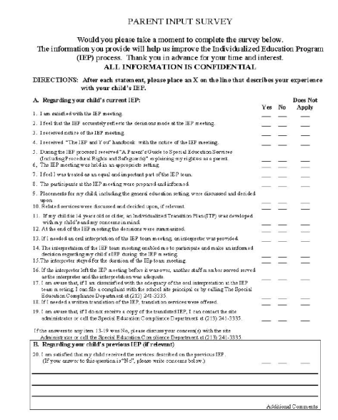
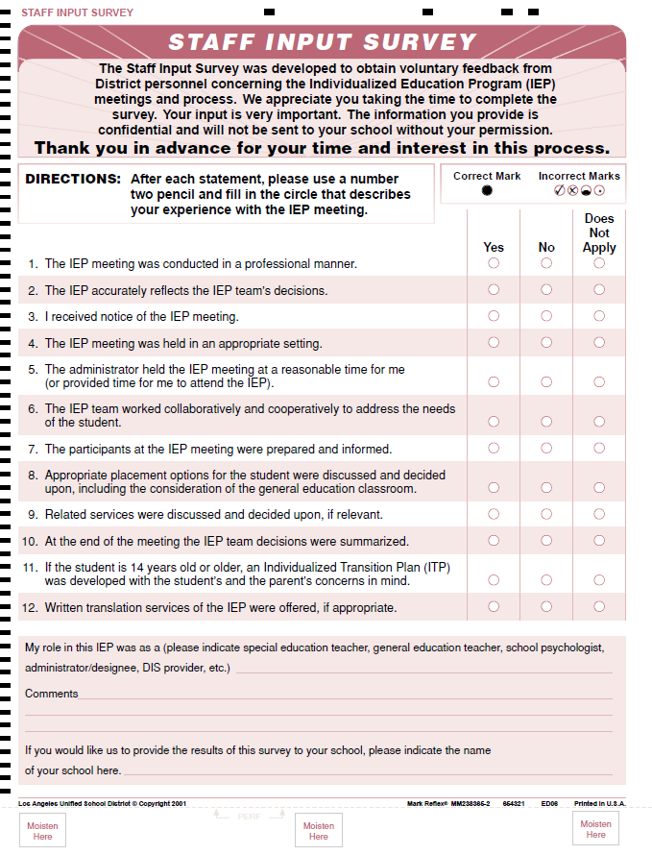
Concluding the Meeting
Provide Parent Input Survey
Provide Staff Input Survey
Notes:
178

Slide 179
Supplemental Pages of Welligent IEP
(as appropriate)

Slide 180
Supplemental Pages
Behavior Intervention Plan
Emotional Disturbance Disability Certification
Expulsion Analysis
Individual Transition Plan
Specific Learning Disabilities Certification
Speech Language Impairment- SLI and LAS pages
Notes:
These are known as the Supplemental Pages to the IEP
We have already reviewed them

Slide 181
Behavior Intervention Plan
Behavior Impedes Learning
  Pattern of behavior disruptions
  Numerous office referrals
  Suspension
Items 1-14
  Assist IEP team to analyze student behavior
  Assist IEP team to develop behavior goal
Required for Students with ED Eligibility
Notes:
Items # 1-4 – identifies the behavior which is impeding learning; determines need in one of the four area
Early stage intervention – behavior not significantly impacting learning of student or classroom functioning, but could escalate if not addressed
Moderate – behavior beginning to significantly impact classroom functioning/ student learning
Serious – behavior may require functional analysis assessment if BSP not successful due to severity of impact on student or others
Extreme – student poses safety issue to self or others
Items #5-7 – prevention; analyzes: environmental factors and necessary changes, predictors and needed intervention
Items #8-11 – analyzes function (purpose) of behaviors; determines new behaviors to be taught and reinforced
Item #12 – determines reactive strategies, if problem behavior occurs again
Item #13 – behavioral goal
Item #14 – communication provisions
Call your local support unit for assistance; Secondary Behavior Specialist

Slide 182
Emotional Disturbance Disability Certification
Used ONLY at:
  Initial
  Three-Year Review
  Comprehensive
Determine if School Has Documented Appropriate Interventions
Eligibility Criteria
IEP Team Considerations
Notes:
Section 1: Review of pre-referral and referral intervention for initial
Series of yes/no questions to determine if school documentation reveal it has provided adequate/appropriate interventions
For students currently receiving special education services, a series of yes/no questions to determine if school has documented modifications, consideration of counseling and behavioral concerns, BSP
Section 2: Deals with assessment
A series of yes/no questions to ensure appropriate assessments have been conducted (health, formal, cognitive, behavioral)
Section 3 -- Determination of Eligibility
If the IEP team has determined that the response to any of the items in 1 or 2 above is NO, the student may not be eligible as a student with ED
Section 4: If the IEP team has determined that the response to the items in 1 and 2 above is YES, the IEP team may consider the criteria for the eligibility of ED by checking one or more applicable characteristics. Refer to ED eligibility prior written notice letter for MCD Outcome 18.
Section 5 -- IEP Team Considerations: IEP team has documented in the IEP:
Consideration of a BSP for initially referred students
Consideration for placement in the LRE including appropriate supports and modifications
Counseling goals if appropriate
Parent participation at meeting determining eligibility and placement

Slide 183
Expulsion Analysis
Completed at Pre-expulsion IEP
Manifestation Determination
  Was misconduct caused/related to disability?
  Was misconduct result of District's failure to implement IEP?
  Were goals and services appropriate and delivered consistently with fidelity? (Check that all services were delivered)
  IEP and Assessment timelines in compliance?
Responses to the questions above determine Whether Expulsion Proceedings Continue
Notes:
Determine if conduct is related to student’s disability:
If not, and the IEP was properly implemented, including all required supports, expulsion proceedings may go forward
If conduct is related to student’s disability, student cannot be expelled; changes must be made to the IEP to assure proper support
AKA – “Manifestation Determination”
Schedule comprehensive IEP within 5 days…
Consult w/ Student Discipline Procedures Board
3 Instances where Principal can unilaterally implement a 45-day alternate interim placement: Weapons, Drugs, Serious Bodily Injury

Slide 184
Individual Transition Plan (ITP)
Required for Students 14 Years and Older
Agency Involvement
Assessment of Interests/Abilities
Coordinated Set of Activities within outcome-oriented process
Promotes movement from school to post-school activities
  Post-secondary education, vocational training, integrated employment, supported employment, adult ed, adult services, independent living or community participation
Functional Vocational Assessment and acquisition of daily living skills, if needed.

Slide 185
Specific Learning Disabilities (SLD) Certification
Complete at Initial, Three-year Reviews, and Comprehensive Evaluations
Certifies Legal Eligibility for Specific Learning Disability
IEP Team Consults with Psychologist
Notes:
Required at initial IEP meetings, 3-year reviews, and comprehensive evaluations
IEP team must identify and describe
Medical conditions which affect student’s ability to learn
Behavioral issues which affect student’s ability to learn
Discrepancy between ability and achievement in one or more academic areas
Psychological process impacting learning
Consider and assure identified factors are not primary cause of discrepancy
If psychologist not in attendance at meeting, IEP team completes form based on previously documented information; however, psychologist should provide input

Slide 186
Speech Language Impairment Eligibility:
SLI certification and LAS Certification
Complete at Initial, Three-year Reviews, and Comprehensive Evaluations
Completed by a Credentialed or Licensed Speech Therapist
See BUL-4191.2 for more information
Notes:
If a student is found eligible for SLI/LAS services
Also for NPA Speech

Slide 187
Specific Learning Disabilities (SLD) Certification
Complete at Initial, Three-year Reviews, and Comprehensive Evaluations
Certifies Legal Eligibility for Specific Learning Disability
IEP Team Consults with Psychologist
Notes:
Required at initial IEP meetings, 3-year reviews, and comprehensive evaluations
IEP team must identify and describe
Medical conditions which affect student’s ability to learn
Behavioral issues which affect student’s ability to learn
Discrepancy between ability and achievement in one or more academic areas
Psychological process impacting learning
Consider and assure identified factors are not primary cause of discrepancy
If psychologist not in attendance at meeting, IEP team completes form based on previously documented information; however, psychologist should provide input

Slide 188
IEP IMPLEMENTATION

Slide 189
Ongoing Requirement – Implementing IEPs
IEPs must be implemented as soon as possible upon parent consent or partial consent as applicable.
  Service Provision
  Classroom Instructional Accommodations
  Behavior Support – schools must cover with existing staff at school
  Teachers and service providers MUST have access to the IEP document or at least the pertinent pages of the IEP in order to fulfill their responsibilities.
  Substitute Teachers must be aware of IEP responsibilities.
  Transportation

Slide 190
Other Follow-up Actions

Slide 191
If Parents Do Not Attend Meeting
Document all attempts in Welligent
Identify Certificated Staff to Review IEP with parent
Send to Parents
  Official IEP Document
  Include 2 copies of consent page (p.10)
    1 copy to be retained by parents
    1 copy to be signed and returned to school
    Remember to follow up in Welligent for any Spanish translations of the IEP as they must be provided to the parent within 30 calendar days.
  Document all actions and communications in Welligent
Notes:
If parents do not attend the IEP meeting, identify a certificated staff member to review the IEP with the parents and answer any questions or concerns they may have. Send parents an official copy of the IEP document. Include 2 copies of the consent page so that the parents can sign one and return it to your school.
191

Slide 192
If Parent Does Not Return Participation and Consent Page…
Reasonable Attempts
  Phone Parent
  Send by US Mail
    Certified
    Return Receipt
  Other
Document in Welligent
  Reasonable Attempts
  See updated procedures per Welligent Announcements

Slide 193
Other Concerns to Address
  Independent Educational Evaluation (IEE) requests – TIME SENSITIVE
  Conserved Students
  Students who are 18 years of age, or will be 18 within one year of the current IEP meeting
  Other District Follow-Up
  Address Translations request in a timely manner
Notes:
Located in Management Screen under Forms. Not part of the IEP print out.
If parent did not attend, a certificated person must review/explain the IEP to the parent
Translation – when the paperwork will be submitted to the Translation Unit, not when IEP will be translated
Make sure appropriate personnel receive pertinent information from IEP, e.g. general education teacher, counselor, testing coordinator, etc.

Slide 194
Delivery of Documents - Spanish IEP Translations
When the IEP translation is completed, the notification that the IEP Translation has been completed and is ready for download will display in Welligent (EDUCATION> My IEP Summary> IEP Task List).
Click the Completed IEP Translation link, enter the date the translation was received, and then click Save to remove the notification from the IEP Task List.
Click Student Search to locate the student by name or District identification number.
Click the name link and the Student Face Sheet will display.
Click IEP Event Listing under Record Navigator located on the left side of the screen.
Click the link of the IEP sent for translation and the IEP Documents screen will display.
Click the Print IEP (Spanish) Give the Spanish translation of the IEP to the parent/guardian along with the “IEP Translation Cover Page” which can be found in Welligent Communications Center>Downloads”.

Slide 195
Post IEP Team Meeting Activities
Make copies of IEP for appropriate school personnel and parent(s)
Attach notifications, assessment plans and assessment reports at the end of the original IEP– (No psych reports in CUM)
File original IEP (original signatures) in green folder located in CUM
If further assessments are needed, create new assessment plan
Follow up on written translations of the IEP as they must be provided to the parent within 30 calendar days.
If a change in placement has been made at the school site, the student information must be updated in the Welligent Classroom Management Module
Notes:
After the completion of the IEP there are several important post IEP follow up activities.
Make copies of IEP for appropriate personnel and parent
Attach notifications, assessment plans and assessment reports at the end of the original IEP– (No psych reports in CUM)
File original IEP (original signatures) in green folder located in CUM
If further assessments are needed, create new assessment plan
Notify Special Education Operations of any changes in transportation or placement (213) 241-6701
Follow up on requests for written translations per REF – 6349. 2 Submitting Requests for Written Translation of Individualized Education Program (IEP) and Related Documents – Remember that written translations of the IEP must be provided to the parent within 30 calendar days.

Slide 196
Strategies for Successful IEP Team Meetings

Slide 197
Before the Meeting
Enter draft* IEP information into the Welligent system with the exception of any placement considerations as they must be discussed and determined at the IEP team meeting
Conduct Preparatory Activity - Consult with various District personnel as appropriate to ensure the Administrator or IEP Chairperson has the information necessary to share with the IEP team at the meeting for discussion and consideration as needed
*Draft information entered into the Welligent system is subject to revision based on IEP team discussion and recommendations.

Slide 198
Before the Meeting
Respond to Parent Requests
  Respond to requests for educationally related records
  Complete assessments, if applicable based on areas identified on the assessment plan
  Arrange for an interpreter, if requested
  Invite District IEP team members, as needed
  Ensure school staff are prepared and will attend the IEP team meeting

Slide 199
If Parent Requests Copies of Draft IEP Pages
  Provide draft pages of Present Level of Performance and Proposed Goals and Objectives- remind parent that all are in draft form and subject to revision by the IEP team of which they will be a member.
    See District Policy REF-3719.0
      Before IEP meeting or
      If IEP Meeting recessed
  Parents must ALWAYS receive a copy of the IEP at the conclusion of the IEP meeting.
DRAFT
Notes:
Parents are entitled to draft copies of the IEP in advance of the IEP meeting if requested in writing.
Again, the parent participation provision in the law requires that the District provide the draft pages if they are available. If available, provide the draft present levels of performance and the draft goal pages. No other pages should be provided as the rest of the IEP will be completed and revised at the meeting by the IEP team which will include the parent.
See the District policy on this: Parental Access to Draft Welligent IEP Pages REF-3719.0
The last bullet is extremely important1 Whenever an IEP meeting is held, whether it is completed or not, the PARENT MUST RECEIVE A COPY OF THE IEP DOCUMENT at the end of the meeting. To avoid a premature signature or consent prior to the completion of an IEP meeting, do not provide the signature page or Section Q page of the IEP to the parent for a recessed IEP meeting.

Slide 200
Prepared with IEP Related Documents
A Parent’s Guide to Special Education Services (Including Procedural Rights and Safeguards), September 2018
  With initial referral for assessment
  With assessment plan
  At IEP meeting
  Parent request
Parent Request for Reasonable Accommodations
  Upon enrollment
  With initial assessment plan
IEP and You
  With IEP meeting notification
ITP and You (for students beginning at age 13*)
  With IEP meeting notification
Least Restrictive Environment Brochure
  At the IEP meeting
  *LAUSD Requires that the ITP be developed by the student’s 14th birthday.
Notes:
A Parent’s Guide to Special Education Services (Including Procedural Rights and Safeguards)
Parent Request for Reasonable Accommodations
IEP and You
ITP and You (Required by LAUSD by 14th Birthday. Develop ITP at IEP Meeting when student is 13 years old)
Least Restrictive Environment brochure

Slide 201
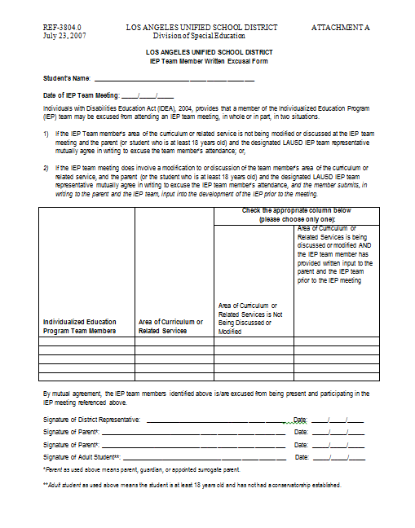
IEP Team Member Excusal Form
  When school staff are not available to attend…
  Refer to District Policy REF-3804.0 for specific guidelines
  Provide to parent with Mtg
  Notification
  Scan and upload to Welligent
  IEP
Notes:
Review the slide.. See District Policy Reference Guide 3804. 0 for detailed procedures.

Slide 202
Strategies for a Productive Meeting
Stay student-centered
Focus on student’s needs
Be an active listener
No sidebar conversations
Watch body language
Ask questions for clarification

Slide 203
Working with Parents
Do not take parents’ complaints personally
Give every consideration to parents’ requests
  Remain calm and pleasant
  Be aware of voice tone and loudness
  Avoid arguing
  Avoid words with negative connotations
  Question rather than state
Notes:
Review the slide.

Slide 204
Make the Connections
Check to see if the items you identified as wanting to learn more about was covered in this training.

Slide 205

Thank you for your attention today !

